Slide 1
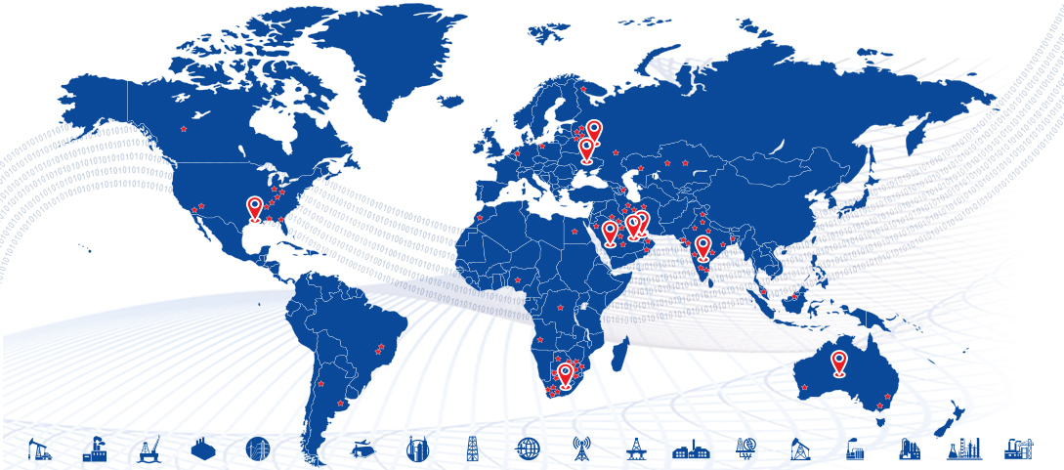





PiLog’s Master Data Management & Governance Solution Demo

Slide 2
Covering Letter
El Sewedy
Dear Sir
Firstly, we would like to thank you for inviting us to respond to the related RFP. This document contains a technical proposal and the pertinent SOW for your kind reference. PiLog would like to assure that we will do everything possible to make this project successful & further help assess the ROI from the investment of the project so that El Sewedy leadership can present the benefits to all it’s stakeholders.
We shall remain at your disposal should you require any additional information. We look forward to hearing from you and we assure of our utmost cooperation, always.
Sincerely,
Umar Farooq
Sales Head
www.piloggroup.com
Restricted Use

Slide 3
PiLog’s value proposition and capabilities – Critical Success Factors
Technical Proposal Content..
Overview of PiLog Group
Data Cleansing, Standardization & De-duplication Methodologies
Taxonomy Orchestration & Standards
Governance Process and Approach
Project Approach & Methodology
Project Deliverables
Key Assumptions, in & Out of Scope
www.piloggroup.com
3
Restricted Use

Slide 4


PiLog - The Digital Transformation Company
Established in 1996, PiLog Group is a global group of independent companies, specializing in Quality Data and Digital Governance & Analytical solutions supporting multiple data domains in a variety of industries all over the globe. The PiLog solutions are state of the art, focused on creating a common business language and managing the rules for the creation of high quality, multilingual terminology using Machine Learning, Artificial Intelligence technologies & human-augmented algorithms for our customers who are eager to transform their businesses digitally.
PiLog provides exclusive technical dictionaries, industrial libraries with content repositories that are the culmination of research, development, and execution over the past twenty years embedded into the platform of PiLog – Data Quality Hub. All our methodologies, processes, solutions are compliant with international standards for delivering seamless systematic integration of content into various platforms and ERPs such as SAP, S4 HANA, Oracle ERP Cloud, Maximo & MS Dynamics, etc.
PiLog India Private Limited, India
PiLog India Labs (R&D)
PiLog Technology Solutions, Abu Dhabi, UAE
PiLog Pty Ltd, Dubai, UAE
PiLog Saudi International, KSA
PiLog Innovative Solutions, Qatar
PiLog Inc, USA

Slide 5











































































PiLog Industry Experience(1/3)
Mill Products, Mining & Chemicals
Aerospace & Defense
Engineering Construction & Operations
www.piloggroup.com
Restricted Use

Slide 6







































PiLog Industry Experience(2/3)
Oil, Gas, and Energy
Industrial Manufacturing
Consumer Products
Public Sector
Telecommunication
www.piloggroup.com
Restricted Use

Slide 7























PiLog Industry Experience (3/3)
Travel & Transport
Utilities
www.piloggroup.com
Restricted Use

Slide 8
PiLog’s value proposition and capabilities – Critical Success Factors
Our Understanding on El-Sewedy Scope of Services
Catalogue, standardize and Cleanse the Material Master Records
Enhance Materials Descriptions through manufacturer Web Research and Pre-Catalogued Repository for data enhancement and standardization
Duplicate Resolution
Providing a Global Master Data Standard and Taxonomy for multiple languages.
Standardize Short and Long/PO descriptions
Apply a standard Taxonomy and UNSPSC classification
Extract and prepare the cleansed data in a predefined template to be uploaded into Oracle
The Governance solution will be implemented across seven locations—Egypt, Algeria, KSA, Qatar, Indonesia, Pakistan, and Tanzania—with Egypt, Pakistan, and Indonesia prioritized for initial rollout.
Governance solution will be integrated with Oracle EBS for all El Sewedy Business Units
The Governance solution will be deployed on-Premise
www.piloggroup.com
8
Restricted Use

Slide 9
PiLog’s Value Engineering
Data Quality HUB
Digital Advisory
Enterprise Data Strategy
EAM Objects
Digitalization Strategy for Gov & Non-Gov
SPIR Management
Inventory Optimization
Asset Lifecycle Mgmt.
Supply Chain Mgmt.
Plant Maintenance Strategy
Value Engineering Portfolio
Services & Contracts Management
Financial Assets Management
Facilities Management
Digital Transformation
Data Governance & Analytics
Business Partner Lifecycle Mgmt.
Single Version of Truth [On-Cloud & On-Premise]
BP Data Migration, Reconciliation and Consolidation
Integration, Sync, Orchestration, Business Services
Data Quality Mgmt.
[ISO, NATO]
BP Portal & Orchestration
Descriptive, Prescriptive & Predictive Analytics
BP Data Regulatory, Statutory Compliance & Governance
iTransform, iVisualize, Industrial Spend
Data Quality Compliance, Maturity Audit
Data Cleansing, Cataloguing & Enrichment
PiLog
www.piloggroup.com
Restricted Use
9

Slide 10
Master Data Management – Organizational Strategy
3
Business Performance
Establish the Digital Analytics platform
Design & Build the InfoGraphics for CXOs
Evaluate the performance of organization based on data insights (KPIs, SLAs etc)
Evaluate the benefits & establish the numbers
1
Consolidation
Acquire/Collect the data from various sources/systems/landscapes
Standardize / Harmonize the datasets using Industry-specific standards & taxonomies
Perform Physical Stock Verification where required
Establish the Single version of truth
Design & Establish the intelligent processes to address the newly available data
2
Governance
Transform the processes to adapt the systematic data flow
Assess, Monitor & Improve the Data quality
Establish centralized teams with strategic objectives for various process
Enforce the governance principles across the organization
© PiLog Group
www.piloggroup.com
Restricted Use
Notes:
Change slide

Slide 11
Solution Architecture & Overview of Material Data Cleansing & Governance
www.piloggroup.com
Restricted Use

Slide 12







Solution Architecture
Data Sources
Data Quality Governance (DQG) Solution
ETL
Material Master (Products)
Service Master
Vendor Master
Customer Master
Asset Master
Master Data Cleansing (DQG)
[Harmonization]
Data Health Assessment
Data Cleansing
Data De-Duplication
Data Harmonization Workbench
Data Upload to Oracle
Restricted Use
Notes:
Change slide

Slide 13









Solution Architecture Framework
Data Source
Data Staging and Test Environment
Validate & Load
Validate & Load
Data Governance
Auto Structure Algorithms
Repository Records (PPR) & Data Libraries
Master Data Dictionary (PPO)
Cleanse
Transformation
Extract
Master Data Project
(Staging Area)
DQG
Data Quality Governance Solution
Legacy
Extract
Business Rules
Materials, Assets, Services
Enrich & Transform
Real Time Integration
Cleanse
Standardization
Data Quality Review
De-Duplication
Industry Standards
Standard Descriptions
New Record Creation
Description Change
Record Extension
Record Deletion/undeletion
Value Standardization
Description Generation
Performance Analysis
Dashboards and Business Reporting
Data Health Assessment
www.piloggroup.com
Restricted Use

Slide 14

Single Version of Truth – Data Cleansing
Data Acquisition from Oracle
Extract & Validate Drawings data
Assign a Class (PPO)
Extract & Validate Reference Data
Extract & populate property values
Restructure Free text (FFT)
Standardize & Abbreviate values
Populate & Validate ERP data
Generate Structured Descriptions
Generate & Confirm Potential Duplicates
Approve & Upload to Oracle
Single Version of Truth
www.piloggroup.com
Restricted Use
Notes:
14

Slide 15
PiLog Preferred Ontology PPO (Taxonomy Standard) & Business Benefits…
PiLog through out the 26 years of experience in master data solutions across different industries have developed PiLog Preferred Ontology (PPO) which is a Technical Dictionary that complies with the ISO 8000 standard. The PPO is a best defined industry specific dictionary covering all industry verticals such as Petrochemical, Iron & Steel, Oil & Gas, Cement, Transport, Utilities, Retail etc.
Each PPO class is a combination of object-qualifier or noun-modifier, which in turn is linked to either a material group or UNSPSC code depending on the customer requirement for the spend analysis. Each class in the PPO dictionary will have a set of properties/attributes with definition, abbreviation, mandatory flag and property sequence.
Business Benefits
Uniformity in Business Communication
Accurate & Cost Effective Sourcing
Unambiguous Identification
Consistent Sales & Purchase Order Descriptions
Potential Duplicate Identification
Visibility of Spend
Optimized Inventory & Supply-Chain Management
Standardized processes
PPO Consists of
Class
Characteristics
Characteristic Sequence
Mandatory Indicator
Class Definition
Characteristic Definition
Class Abbreviation
Characteristic Abbreviation
Description Generation Rules
Standard Values
Standard Value Abbreviations
PPO
(PiLog Preferred Ontology)
PRO
(Ontology of all PiLog Clients)
OTD Registry
(Over 1.4
million concepts)
OTD: Open Technical Dictionary
CPO
(Client/Corporate Preferred Ontology)
ISO 22745 & ISO 8000 Complaint
www.piloggroup.com
Restricted Use

Slide 16
PiLog Applied - Master Data Quality Standards (ISO 8000)
Data Portability
ISO 8000
Data Portability
Data Requirement
ISO 8000-110
Class/Concept Definition, unique identifier
Quality data is portable data; it is independent of the software application
Data Terminology & Localization
PPO: ISO 8000-110
Common Business Language
Data Classification
ISO 22745
Linking PPO class to classification (UNSPSC)
Provenance – Traceable History at record level
Data Traceability
ISO 8000-120
Property/Concept Definition, unique identifier
Business Requirements
Multi-lingual
Linking PPO class to classification (spend tree)
Technical Dictionaries & Exchange of Characteristics Data
ISO 29002
Technical Dictionaries
Exchange of characteristics data in xml format
Owner of the data created
ISO 8000
Master Data Quality
ISO 22745
Open Technical Dictionaries
ISO 29002
Exchange of Characteristics data
www.piloggroup.com

Slide 17
Taxonomy / Ontology Orchestration
Open Technical Dictionary [Public Registry]
Open Technical Dictionary [PiLog’s Registry]
PiLog Preferred Ontology
[PPO]
Customer Preferred Ontology
[CPO]
OTD
ISO 22745
ISO 8000
ISO 22745
ISO 8000
Dictionary
ISO 22745
ISO 8000
Dictionary
ISO 22745
ISO 8000
Data Requirements (Templates)
Data Requirements (Templates)
Concept Types
Class : AMPLIFIER
Property: VOLTAGE
UOM: VOLT
Property Value: 24 / 120
Currency: $, £, € , SAR
QOM: Nominal, Min, Max
Data Requirement / Specifications (Template)
Class + Class definition + Abbreviation
Property + Prop def + Prop Abbr. + Mandatory Ind + data type + description indicator + Seq
www.piloggroup.com
17
Restricted Use

Slide 18

Taxonomies & Classifications in the International market
Shell MESC
Noun
Modifier
Code
Class
Intermat SMD
NAG
Noun
Noun Synonyms
Modifier
Characteristics
Trade Ranger
Category
Group
Noun/Modifier
Attribute 1 … 25
eCl@ss
Class
Attribute
Value
RUS
Classification
Attributes Native
Template Attributes
Customer Attributes
PiLog Taxonomy
PPO-OTD
(ISO 22745, ISO 8000)
Discipline
(Material /Service Group)
Verb-Noun-Modifier
Action-Object-Qualifier
Properties/Characteristics
Reference Data
Documentation Data
Sourcing Info
Conversion
Languages
SMD changes
Industry changes
Company changes
UNSPSC
Segment
Family
Class
Commodity
Item Description
NATO
(NSN/FIIG)
Group
Class
NCB
IIG
Item Name
ESCI (Class)
ESPI (Properties)
External References
(H2, H6, INC, MRC)
ISIC
Section
Division
Group
Class
Branch
Others
EAN
UDCI
ISBN
www.piloggroup.com
Restricted Use

Slide 19
Advantages of UNSPSC
Company-wide visibility of spend analysis (i.e., a uniform view of all spending across the enterprise)
Identification of relevant suppliers for a specific product or service
Grouping of similar products and services under a single category which will have awareness of the products and services
Exploitation of eCommerce capabilities i.e., strategic analysis of purchasing activities and patterns
It is capable of expressing a good degree of granularity.
It has the ability to support different levels of granularity in different categories (so that drill down is only available where it makes sense)
It is managed and updated on a regular basis by the United Nations and GS1 US
Easier navigation by commodity for end users to find items to be requisitioned
It is a hierarchical taxonomy that enables users to “roll up” or “drill down” their spending analysis in order to obtain the desired level of specificity
www.piloggroup.com
Restricted Use

Slide 20
UNSPSC Coding
The United Nations Standard Products and Services Code [UNSPSC] is a coding system for goods and services. It enables buyers and sellers to describe goods and services in a common way without referring to any suppliers' in-house catalogue codes and descriptions. It is a four-level hierarchy coded as an eight-digit number, Segment-Family-Class-Commodity
For instance, the UNSPSC Code for Molded Case Circuit Breaker is “39121616”
The four- level hierarchy is as follows:
Hierarchy | Segment | Family | Class | Commodity
UNSPSC Code | 39000000 | 39120000 | 39121600 | 39121616
UNSPSC Descrption | Electrical Systems and Lighting and Components and Accessories and Supplies | Electrical equipment and components and supplies | Circuit protection devices and accessories | Molded case circuit breakers
UNSPSC Coding
UNSPSC Hierarchy
PiLog
Restricted Use
20

Slide 21
MDRM UNSPSC Codification Logic (Materials)
Material Master Series: 1 to 6
Sl. No | Level | Code | Description
1 | Segment | 39000000 | Electrical Systems and Lighting and Components and Accessories and Supplies
2 | Family | 39120000 | Electrical equipment and components and supplies
3 | Class | 39121600 | Circuit protection devices and accessories
4 | Commodity | 39121615 | Air circuit breakers
Example: Generated ERP No: MEL391216150116
M – Stands for Material, EL – Stands for Electrical, 39121615 - UNSPSC 8 digit, 0116 – running sequence no
Description: BREAKER, CIRCUIT; TYPE: AIR, CURRENT RATING: 1250 A, VOLTAGE RATING: 415 V AC, ELECTRICAL POLE QUANTITY: 4P, INTERRUPT CAPACITY: 50 KA, TEMPERATURE RATING: 80 DEG C, WIDTH: 414 MM, LENGTH: 396.5 MM, HEIGHT: 461 MM, STANDARD: IEC 62271-102; MANUFACTURER PART NO: 1SDA055757R1, MANUFACTURER: ABB, EQUIP/TAG MODEL: 20100051; (4) AUXILIARY CONTACT
Thus 'Air circuit breakers' are coded as 39121615, 'Molded case circuit breakers' are coded as 39121616 and 'Oil circuit breakers' as 39121645. The class of 'Circuit protection devices and accessories' is 39121600; the family of 'Electrical equipment and components and supplies' is 39120000, and all in the segment 39000000 of 'Electrical Systems and Lighting and Components and Accessories and Supplies’.

Slide 22





Sample Data Harmonization/Cleansing Process (Material)….
Data Manager
Data Cataloguing
Data QA/QC
Client QA/QC
Batch
Release for Cataloguing
Data Review
Data Sampling
Acquire
Data
Load Data
Run Analyzers
Assign Class
Perform Value Standardization
Data Review
Capture and Enrich the property values
Run Description Generation
Data Approval/
Rework
Review Results
Capture Reference Info/Walkdown
Run QC Tools
Bad Data
Run QC Tools
Release to Client for Review
Prepare Batch
Export Data
Release for QC
Production Instance
PDR
© PiLog Group
Strictly Confidential
22

Slide 23
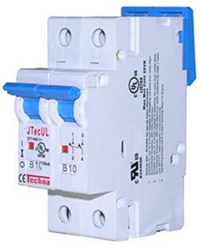
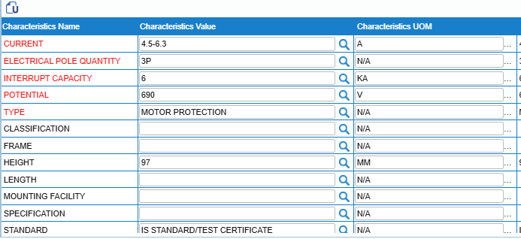
Examples of Data Cleansing Approach..
Assign Class
Class Name: Breaker, Circuit
Populate Properties
Client Source: MPCB,6.3AMPS,RANGE:4.5-6.3A 3RV11211GA10
Catalogued Description
BREAKER, CIRCUIT; TYPE: MOTOR PROTECTION, CURRENT: 4.5-6.3 A, POTENTIAL: 690 V, ELECTRICAL POLE QUANTITY: 3P, INTERRUPT CAPACITY: 6 KA, TEMPERATURE RANGE: -50 TO 80 DEG C, HEIGHT: 97 MM, STANDARD: IS STANDARD/TEST CERTIFICATE; FFT: RELAY RANGE: 4.5A-6.3 A, CLASS-10, SIRIUS; MODEL NO: 3RV1121-1GA10, MANUFACTURER: SIEMENS
© PiLog Group
Strictly Confidential

Slide 24
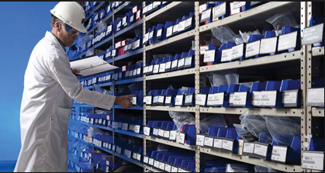
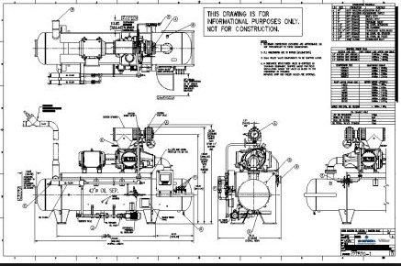
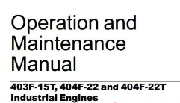


Material Master – Enrichment example…
Enrichment is the process of sourcing additional information about a material item from physical inspection or external sources like the internet, manufacturer catalogues or engineering drawings.
Item Number: 123456
Current Catalogue Description
BRG , NSK PN: 6206ZZC3 62*16 , 11979 FOR MOTOR
PiLog Data Repository
(10 Million Records)
Catalogued
BEARING, BALL:
TYPE: DEEP GROOVE
ROW: SINGLE
INSIDE DIAMETER: 30MM
OUTSIDE DIAMETER: 62MM
WIDTH: 16MM
CAGE MATERIAL: PRESSED STEEL
CLOSURE TYPE: SHEILDED
IBI: 11979
APPLICATION: MOTOR
BEARING, BALL:
OUTSIDE DIAMETER: 62MM
WIDTH: 16MM
IBI: 11979
APPLICATION: MOTOR
Enriched
P/N: 6206ZZC3 NSK
P/N: 6206ZZC3
Manufacturer: NSK
www.piloggroup.com

Slide 25
Standardization of Property Values
S.no | Class | Property Name | Property Value (While Cataloguing) | Property Value (Standardized Value)
1 | PIPE | MATERIAL | STAINLES STEEL | STAINLESS STEEL
2 | PIPE | MATERIAL | SS | STAINLESS STEEL
3 | VALVE, BALL | SIZE | ¼ IN | ¼ IN
4 | VALVE, GATE | SIZE | 0.25 IN | ¼ IN
5 | CONTACTOR | POLE QUANTITY | 3 POLES | 3P
6 | CONTACTOR | POLE QUANTITY | 3-P | 3P
www.piloggroup.com

Slide 26
Standardization of Reference Data
S.no | Class | Part Number (while Cataloguing) | Part Number (Standardized Value)
1 | BEARING, BALL | 7309 BECBP | 7309 BECBP
2 | BEARING, BALL | 7310-BECBP | 7310 BECBP
3 | CONTACTOR | LC1 D80G7 | LC1D80G7
4 | CONTACTOR | LC1 -D1 8 GD | LC1D18GD
5 | BREAKER, CIRCUIT | GV2-L20 18A | GV2L20 18A
6 | BREAKER, CIRCUIT | GV2ME10/4-6.3A | GV2ME10 4-6.3A
www.piloggroup.com

Slide 27
Standardization of Vendor Names
S.no | Class | Vendor Name | Vendor Name(Standardized Value)
1 | BREAKER, CIRCUIT | TELEMECHANIQUE | TELEMECANIQUE
2 | CONTACTOR | SCHNEIDER ELECTRIC | SCHNEIDER ELECTRIC
3 | CONTACTOR | SCHNEIDER | SCHNEIDER ELECTRIC
4 | KIT | ATLAS CAPCO | ATLAS COPCO
5 | COMPRESSOR | ATLAS | ATLAS COPCO
www.piloggroup.com

Slide 28
Potential Duplicate Resolution (PDR)
Potential Duplicates identification is the process to identify the duplicates across the material master data. There are two ways to identify the duplicates
PDR-1 is the process of identifying items that have same part number/model number
PDR-2 is the process of identifying materials that might not have part/model numbers but have the same mandatory properties
PDR-1 and PDR-2 will be performed after data cleansing
The success factor to identify more duplicates is Standardization
Standardization also enables more effective search functions, along with structured description generation, which leads to more effective purchasing
www.piloggroup.com

Slide 29
Duplicate Materials Examples
SAP Code | ERP Description (Before) | Catalogued Description After Cataloguing | Remarks
10059391 | VALVE, SOLENOID;TYPE DIRECTIONAL CONTROL; P/N: 4WE 10 J 3X/C G24N9K4,Mnfr: REXROTH;FFT: (X=3); FOR GROUPING/UNGROUPING HYDRAULICPOWER PACK | VALVE, SOLENOID; TYPE: HIGH DIRECTIONAL SPOOL, OPERATED: DIRECT; MANUFACTURER PART NO: 4WE10J3X/CG24N9K4, REFERENCE NO: R900589988 | Master
10177340 | VALVE,CONTROL,TYPE:DIRECTIONAL,TYPE OF OPERATION:SOLENOID,SPECIALREQUIREMENT:CE TOP 5,PRESSURE RATING:4600 PSI,SIZE:D05,REF:4WE10J3X/CG24 N9K4,PN:D28137 | VALVE, SOLENOID; TYPE: HIGH DIRECTIONAL SPOOL, OPERATED: DIRECT; MANUFACTURER PART NO: 4WE10J3X/CG24N9K4, REFERENCE NO: R900589988 | Duplicate
10003996 | VALVE, SOLENOID;P/N: 4WE 10 J3X/CG24N9K4; OPERATED: DIRECT, TYPE:HI-DIRECTIONAL SPOOL; REFERENCE: R900589988, | VALVE, SOLENOID; TYPE: HIGH DIRECTIONAL SPOOL, OPERATED: DIRECT; MANUFACTURER PART NO: 4WE10J3X/CG24N9K4, REFERENCE NO: R900589988 | Duplicate
10165938 | PLUG,PIPE,1/8 ST,SQUARE HEAD ,PN:2-542-001-376-00,FOR PITCH DOSINGPUMP,MODEL:LQ-224A,MAKE:VIKING | PLUG; TYPE: PIPE, DIAMETER: 1/8 "; OEM PART NO: 2-542-001-376-00, EQUIP/TAG MODE: LQ-224A | Master
10006190 | PLUG, PIPE;P/N: 2-542-001-376-00; DIAMETER: 1/8 IN; EQUIP/TAGMODEL: LQ-224A, | PLUG; TYPE: PIPE, DIAMETER: 1/8 "; OEM PART NO: 2-542-001-376-00, EQUIP/TAG MODE: LQ-224A | Duplicate
10117666 | SILENCER;TYPE EXHAUST, CONNECTION SIZE 1/4 ", SPECIFICATIONFOR SOLENOID VALVE; OEM P/N: T40C2800,OEM: NORGREN | SILENCER; VENDOR: ICM, OEM PART NO: T40C2800, VENDOR: NORGREN | Master
10086429 | SILENCER; OEM P/N: T40C2800;SILENCER;ICM;OEM: NORGREN | SILENCER; VENDOR: ICM, OEM PART NO: T40C2800, VENDOR: NORGREN | Duplicate
Strictly Confidential

Slide 30
Business Benefits of Master Data Cleansing & Governance…
Improved Decision-Making: Clean, accurate material data ensures that businesses have reliable information about stock levels, material specifications, and usage patterns. This enables better forecasting, procurement decisions, and resource allocation, reducing the risk of costly errors.
Cost Reduction: By eliminating duplicates, outdated entries, or inconsistencies in material records (e.g., multiple entries for the same item under different names), businesses can avoid over-ordering, excess inventory, or unnecessary purchases. This streamlines operations and cuts waste
Enhanced Operational Efficiency: Clean data reduces manual workarounds and errors in processes like order fulfillment, production planning, or supplier coordination. Automated systems perform better with consistent data, speeding up workflows and minimizing downtime.
Better Supplier Management: Accurate material data helps businesses maintain clear records of supplier details, pricing, and lead times. This strengthens negotiation power, ensures compliance with contracts, and prevents over-reliance on specific vendors due to data confusion
Regulatory Compliance and Risk Mitigation: In industries like manufacturing, healthcare, or aerospace, inaccurate material data can lead to non-compliance with safety or quality standards. Cleansing ensures traceability and adherence to regulations, reducing legal and reputational risks.
Improved Customer Satisfaction: With reliable material data, businesses can fulfill orders accurately and on time, avoiding delays or substitutions that frustrate customers. This builds trust and loyalty.
Support for Digital Transformation: Many companies are adopting technologies like AI, IoT, or ERP systems. Clean Data cleansing ensures these tools work effectively by providing high-quality inputs, maximizing ROI on tech investments.
Restricted Use

Slide 31
Data Health/Maturity Assessment of existing Material master Data Records
www.piloggroup.com
Restricted Use

Slide 32
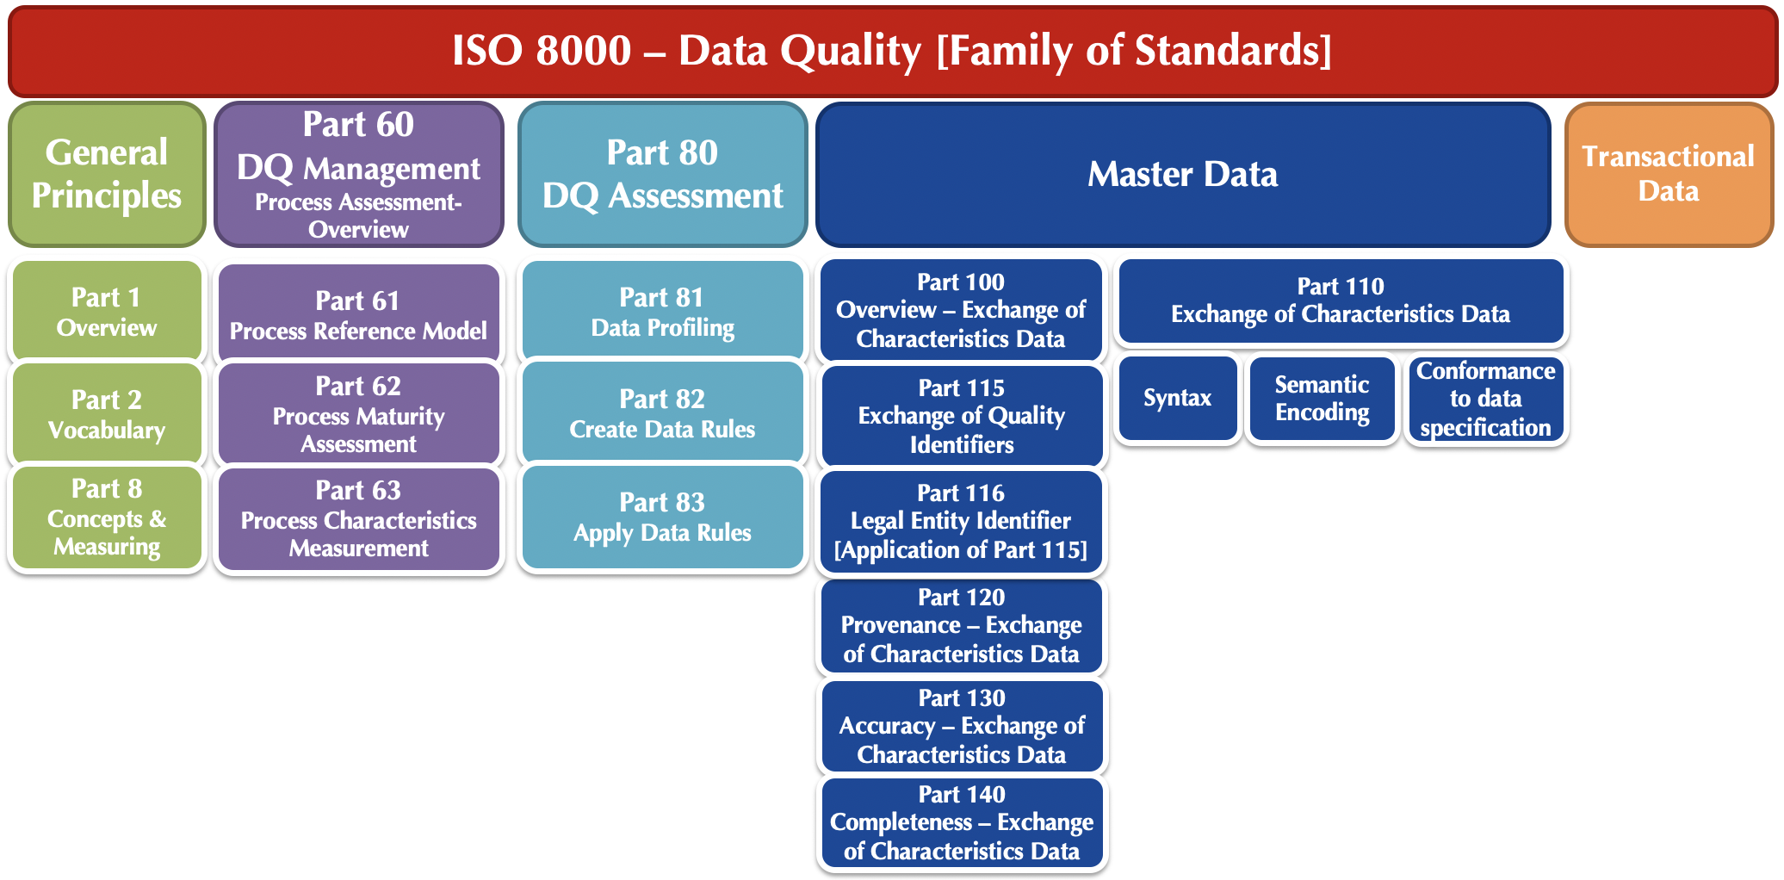
Data Quality Assessment
Data Quality
Completeness
Accuracy
Consistency
Availability
Timeliness
Traceability
Validity
Integrity
Accessibility
Precision
Representation
www.piloggroup.com
Restricted Use
Notes:
Data Completeness
The state or condition of having all the necessary data elements of the dataset completed
Kind of the data
Industry specific
Who & where the data would be used
Data Accuracy
Data elements must have the right values and must be represented in a consistent and unambiguous form
Data Type
Field Length
Qualifier of measure
Data Source
Dependency
Syntax
Data Traceability
The capability of keeping track of a given data set or data elements or data values to a given degree
Data source
Trust level of the data source
Audit trails/Change log – who changed when and for what reason
Data Consistency
The consistency ensures that any changes will bring the data set from one valid state to another. Any changes written to the data set must be valid according to all defined rules, including constraints, and any combination thereof
Data remains same during any point-in-time
Distributed systems, all nodes to have the same value for the data element
Single version of the data in all the integrated/collaborated systems
Referential integrity
Data Timeliness
Data timeliness is at an appropriate or opportune moment in time
Data lineage
Data value decay rate
Relevance to the present times
Data aging
Data Validity
It is the extent to which a data entity or element or value is well-founded and corresponds accurately to the real world
Allowed values
File format
Uniqueness
Security checks
Cross-system checks
Data Availability
Data is available to the systems, users & processes at all times, without loosing its true value

Slide 33
Data Quality Dimensions (Finance, Material, Customers, Vendors, Service etc.)…
Data Completeness
The state or condition of having all the necessary data elements of the dataset completed
Data Accuracy
Data elements must have the right values and must be represented in a consistent and unambiguous form
Data Traceability
The capability of keeping track of a given data set or data elements or data values to a given degree
Data Consistency
The consistency ensures that any changes will bring the data set from one valid state to another. Any changes written to the data set must be valid according to all defined rules, including constraints, and any combination thereof
Data Timeliness
Data timeliness is at an appropriate or opportune moment in time
Data Availability
Data is available to the systems, users & processes at all times, without loosing its true value
Data Validity
It is the extent to which a data entity or element or value is well-founded and corresponds accurately to the real world
Data Quality
Completeness
Accuracy
Consistency
Availability
Timeliness
Traceability
Material
Vendor
Asset
Service
www.piloggroup.com
Restricted Use

Slide 34
Examples of Data Health Assessment (Inconsistencies in the Existing Descriptions..)
Material Number | Original Short | Remarks
15137631 | BEARING DEEP GROOVE;6222-2Z;DN4005;SKF | Deep Groove is catalogued in different formats
400002113 | BEARING DG BALL 6000 2Z
400002422 | BEARING SPH ROLER 22213 EK C3 | Spherical is catalogued in different formats
400028328 | BEARING SPHERICAL PLAIN SS GE50EC NIRO
400002852 | BRG CYL ROLER QJ320 N2MA | Bearing and Roller are not standardized.
400021149 | BEARING TAPER ROLLER 31310 J2/QCL7CDF
400002745 | BRG CYL RPLLER NU 318 C3
400010465 | HOUSING COVER DG 02-02-03-001,PART NO:2 | The format of part number and Housing are not standardized.
400010466 | HSG DEFLECTOR,DG 02-02-03-001,PRT NO:3
400023211 | COMPRESSOR 75LRA 3P 380VMOD:ZR57KC-TFC | The format of model number is not standardized.
600000201 | DISK FILTER VACCUM SEAL MODEL:D3800
Note: These are just Sample reports
Restricted Use

Slide 35
Examples of Data Health Assessment (Duplicates Based on Part Number..)
Material No | Short text Description | Manufacturer Part Number
400002090 | BRG DG BALL 6308 | 6308
400002094 | DG BALL BRG 6308 | 6308
400002264 | BRG DG BALL 6000 2Z | 6000 2Z
400002113 | BEARING DG BALL 6000 2Z | 6000 2Z
400002163 | BRG DG BALL 6216 2Z | 6216 2Z
15137628 | BEARING DEEP GROOVE;6216-2Z;DN4005;SKF | 6216-2Z
400002160 | BRG DG BALL INSULATED 6224 C3 | 6224 C3
400002335 | BRG DG BALL 6224 C3 | 6224 C3
400002055 | BEARING DG BALL 6320 C3 | 6320 C3
400002054 | BRG DG BALL 6320 C3 | 6320 C3
400002753 | BRG CYL ROLER NU 211 ECJ | NU 211 ECJ
400002751 | BRG CYL ROLER NU211 ECJ | NU211 ECJ
400002761 | BRG CYL ROLER NU 320 ECJ | NU 320 ECJ
400002764 | BRG CYL ROLER NU 320ECJ | NU 320ECJ
400002443 | BRG SPH ROLER 22213 EK C3 | 22213 EK C3
400002422 | BEARING SPH ROLER 22213 EK C3 | 22213 EK C3
Note: These are just Sample reports
Restricted Use

Slide 36
Examples of Data Health Assessment (Report on Top Commodities..)
Commodity | Approx. Count
VALVE | 20,547
BEARING | 12,364
RING | 8,767
O RING | 7,336
SCREW | 6,645
GASKET | 5,341
SEAL | 4,979
SWITCH | 2,531
FUSE | 1,727
MOTOR | 804
Note: These are just Sample reports
Restricted Use

Slide 37
Examples of Data Health Assessment (Material Group Discrepancies..)
Material Number | Source Description | Material Group | Material Grp Desc
2100485740 | CLR FASCIA;E-SQ ALLIANCE PVT.LTD. | 27113201 | TOOLS AND TACKELS
2200060160 | CLR FASCIA;E-SQ ALLIANCE PVT.LTD. | 27000000 | GNRL ITEMS & SPRS
2100446605 | BLK, CLMP (120LONG);10278640C | 31162900 | HOLD & CLAMP DEVICES
4100002676 | BLK, CLMP (120LONG);10278640C | 23000000 | INDS MCHN COMP & SPR
2200167222 | DETCTR,RESISTNCE TEMPRTRE,PT-100;442 MM | 41112200 | MSRNG/INDCTG DEVICES
9100055383 | DETCTR,RESISTNCE TEMPRTRE,PT-100;442 MM | 32101519 | PROJECT ITM & SPRS
2100135670 | FLTR RGLTR,P/N:11-4SN-201M-M6KA-NB | 41104011 | FILTER ELEM & ACCESS
2200052115 | FLTR RGLTR,P/N:11-4SN-201M-M6KA-NB | 40151800 | COMPRESSOR SPARES
3200004061 | FRNTR,ALMRH,STO;1219.2 X 1828.8MM | 41112200 | LIFTING EQUIPMENT
8100021197 | FRNTR,ALMRH,STO;1219.2 X 1828.8MM | 44120000 | ADMIN AND STATIONARY
Note: These are just Sample reports
Restricted Use

Slide 38
Targeted Results of Data Maturity Assessment Analysis (1/2)
Improved organizational efficiency, communication and reduction in cost by reducing inefficiency, poor communication and duplication of Inventory
Elimination of duplicate material items
Reduction in cost of using current descriptions through improved efficiency, reliance and assurance of accurate and unique descriptions by Engineers, operations personnel, material warehousing, logistics, finance and purchasing
Improved purchase contracting and reduced material cost by elimination of duplicate items and reliance on volumes used and needed
Improved Inventory receipt process with complete and accurate material descriptions
Improved inventories of material items and reduction of Inventory variances with unique and accurate materials descriptions
Reduction of Excess and obsolete through accurate, unique and complete descriptions used in the purchase, receipt and warehousing of items
Restricted Use

Slide 39
Targeted Results of Data Maturity Assessment Analysis (2/2)
Improved material item availability and reduction of operation stoppage and or rush order shipping through elimination of duplications and proper minimum and maximum stock levels
Reduced cost to set up new material items. Cost moved from fixed internal cost to variable external cost
ISO compliant content and standardization processes
Master Data portability, provenance, completeness
Various powerful, accurate and quick search capabilities with which we can save lot of time
ERP standard data look-ups & Enforced mandatory checks
Process will stop where governance rules are not adhered
Synchronous and Asynchronous interfaces with popular ERP Systems
Replicate Master Data seamlessly via Create, Change, Extend, Delete & Undelete interfaces with SAP
Restricted Use

Slide 40
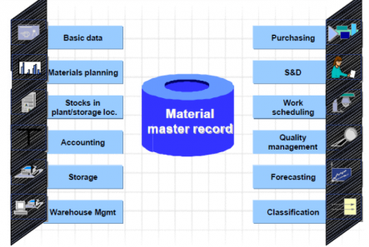

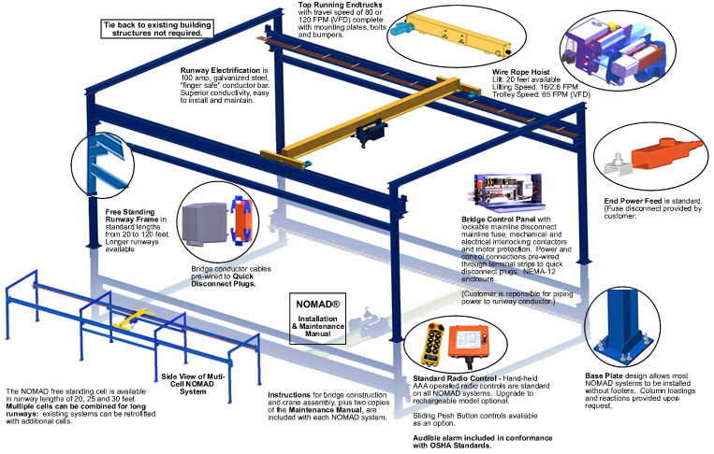
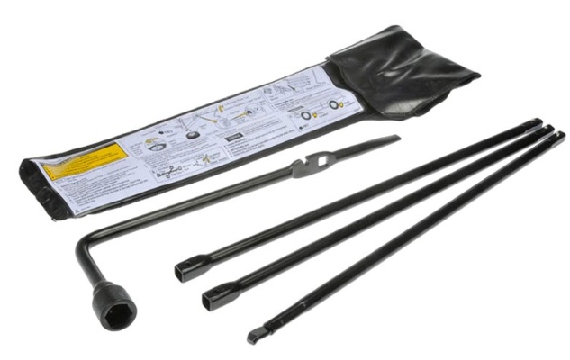

Process of accomplishing Item / Material Master objects (Sample Model)...
1
Item / Material Master Cleansing Services (ISO 8000)
3
Plant Walk down for acquiring missing information Materials
Source Information
Data Extracted from Manuals, Data Sheets, Catalogues, ERP Systems
2
100% cleansed and link to Parent Equipment
4
Image Capturing of Warehouse/Inventory Materials
5
Master Data Governance Solution – Technology Platform:
(Industry best practices for data management
Inventory Optimization
Refined & Efficient Procurement Processes
Increased operational efficiency & compliance
www.piloggroup.com
Restricted Use

Slide 41
Industry Agnostic & Utility Industry Standards, Policies, Procedures & Compliance
“Embark on Industry Best Practices – Best Run Business, Run on Good Data Standards”
www.piloggroup.com
Restricted Use

Slide 42
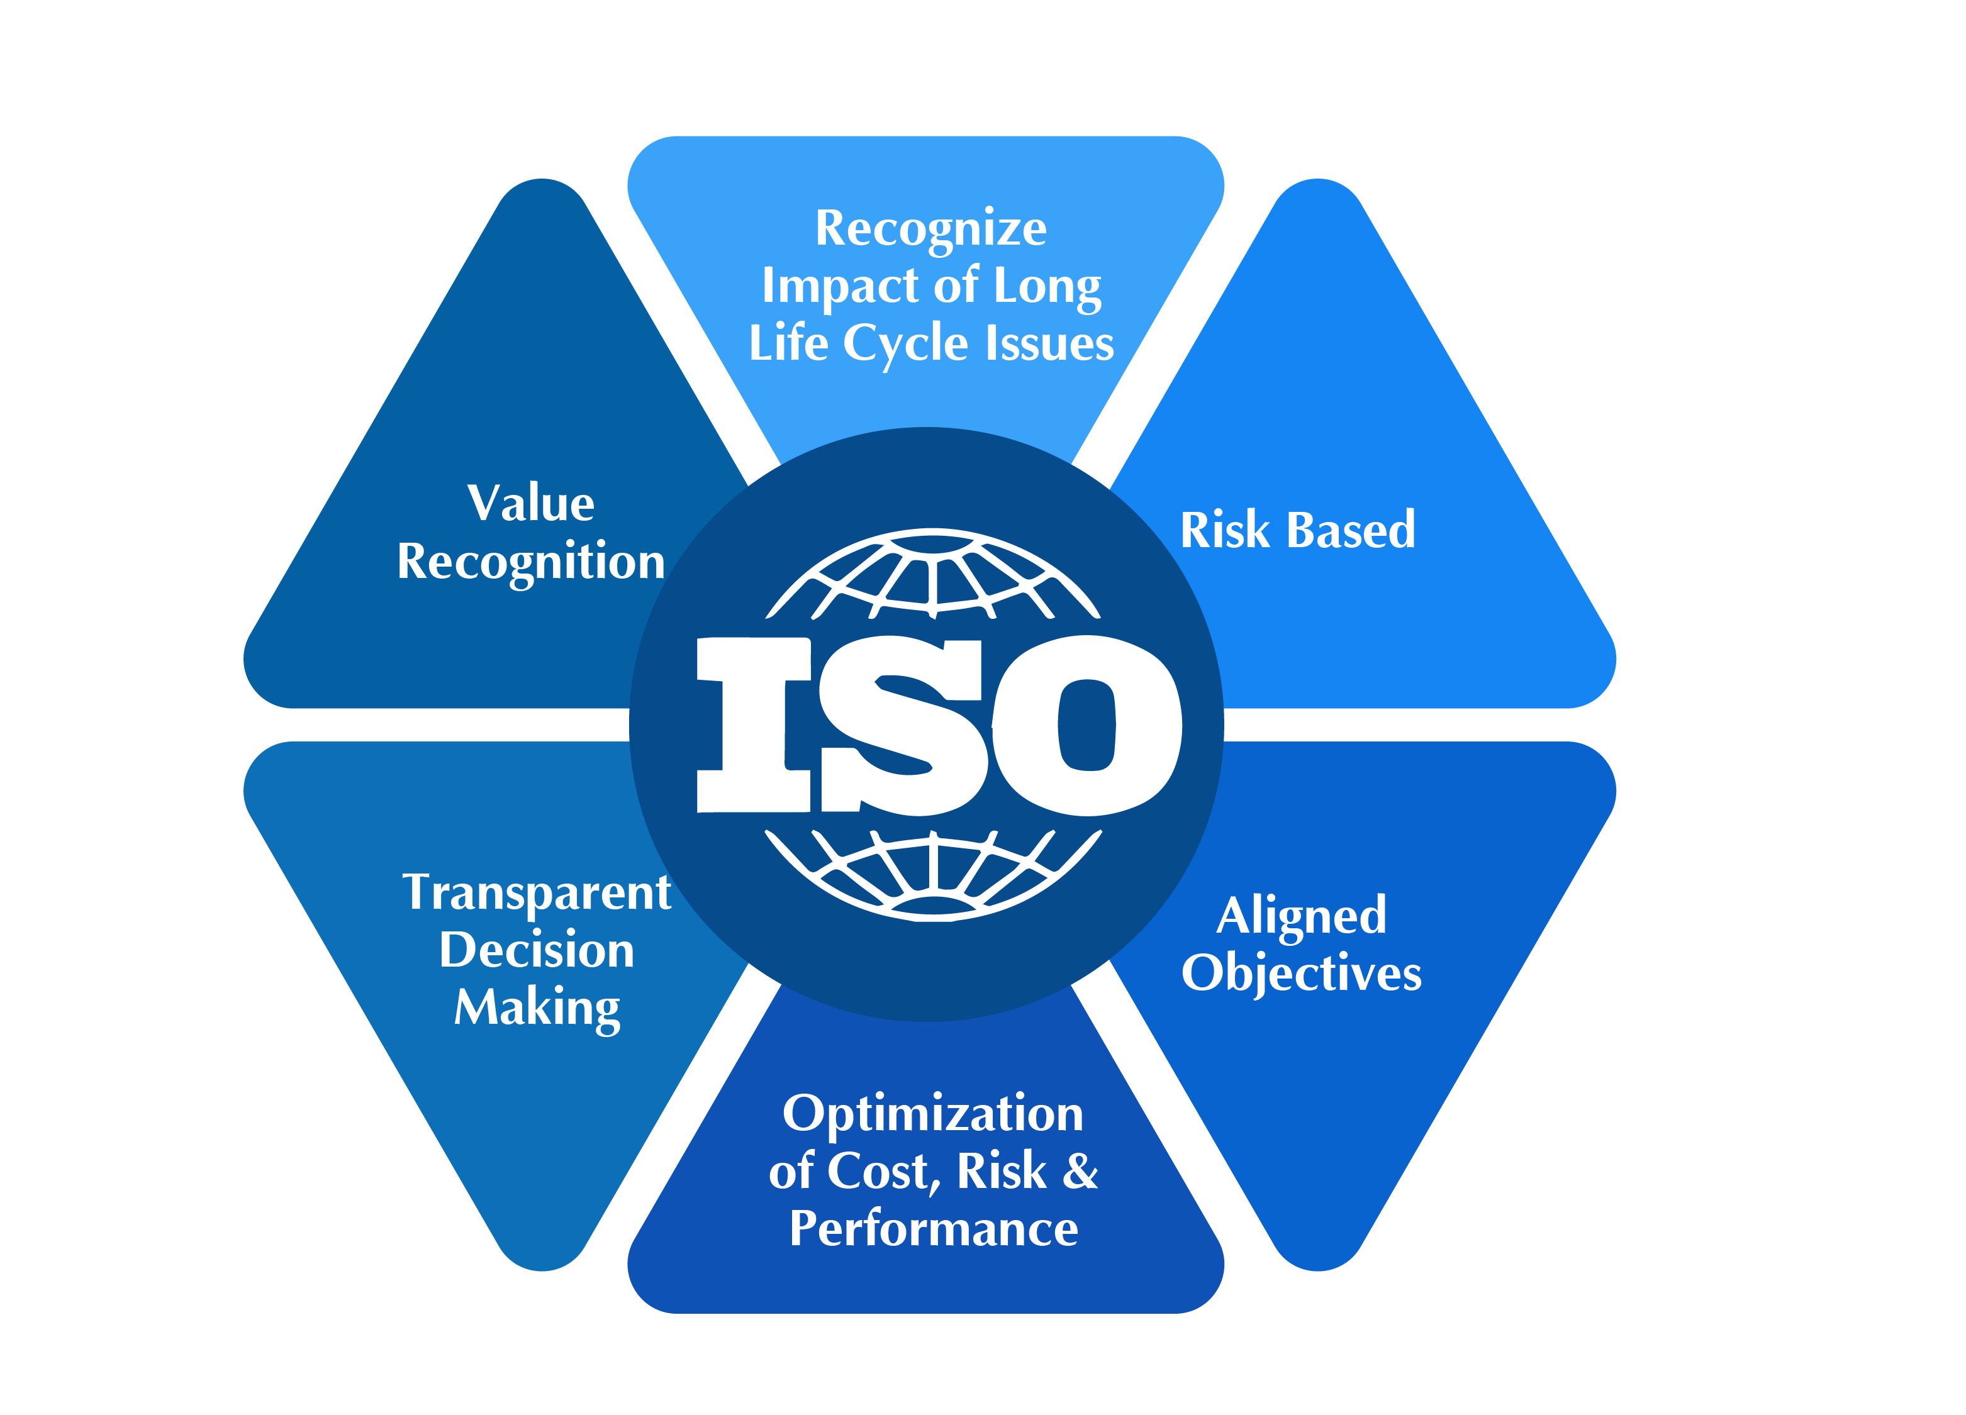
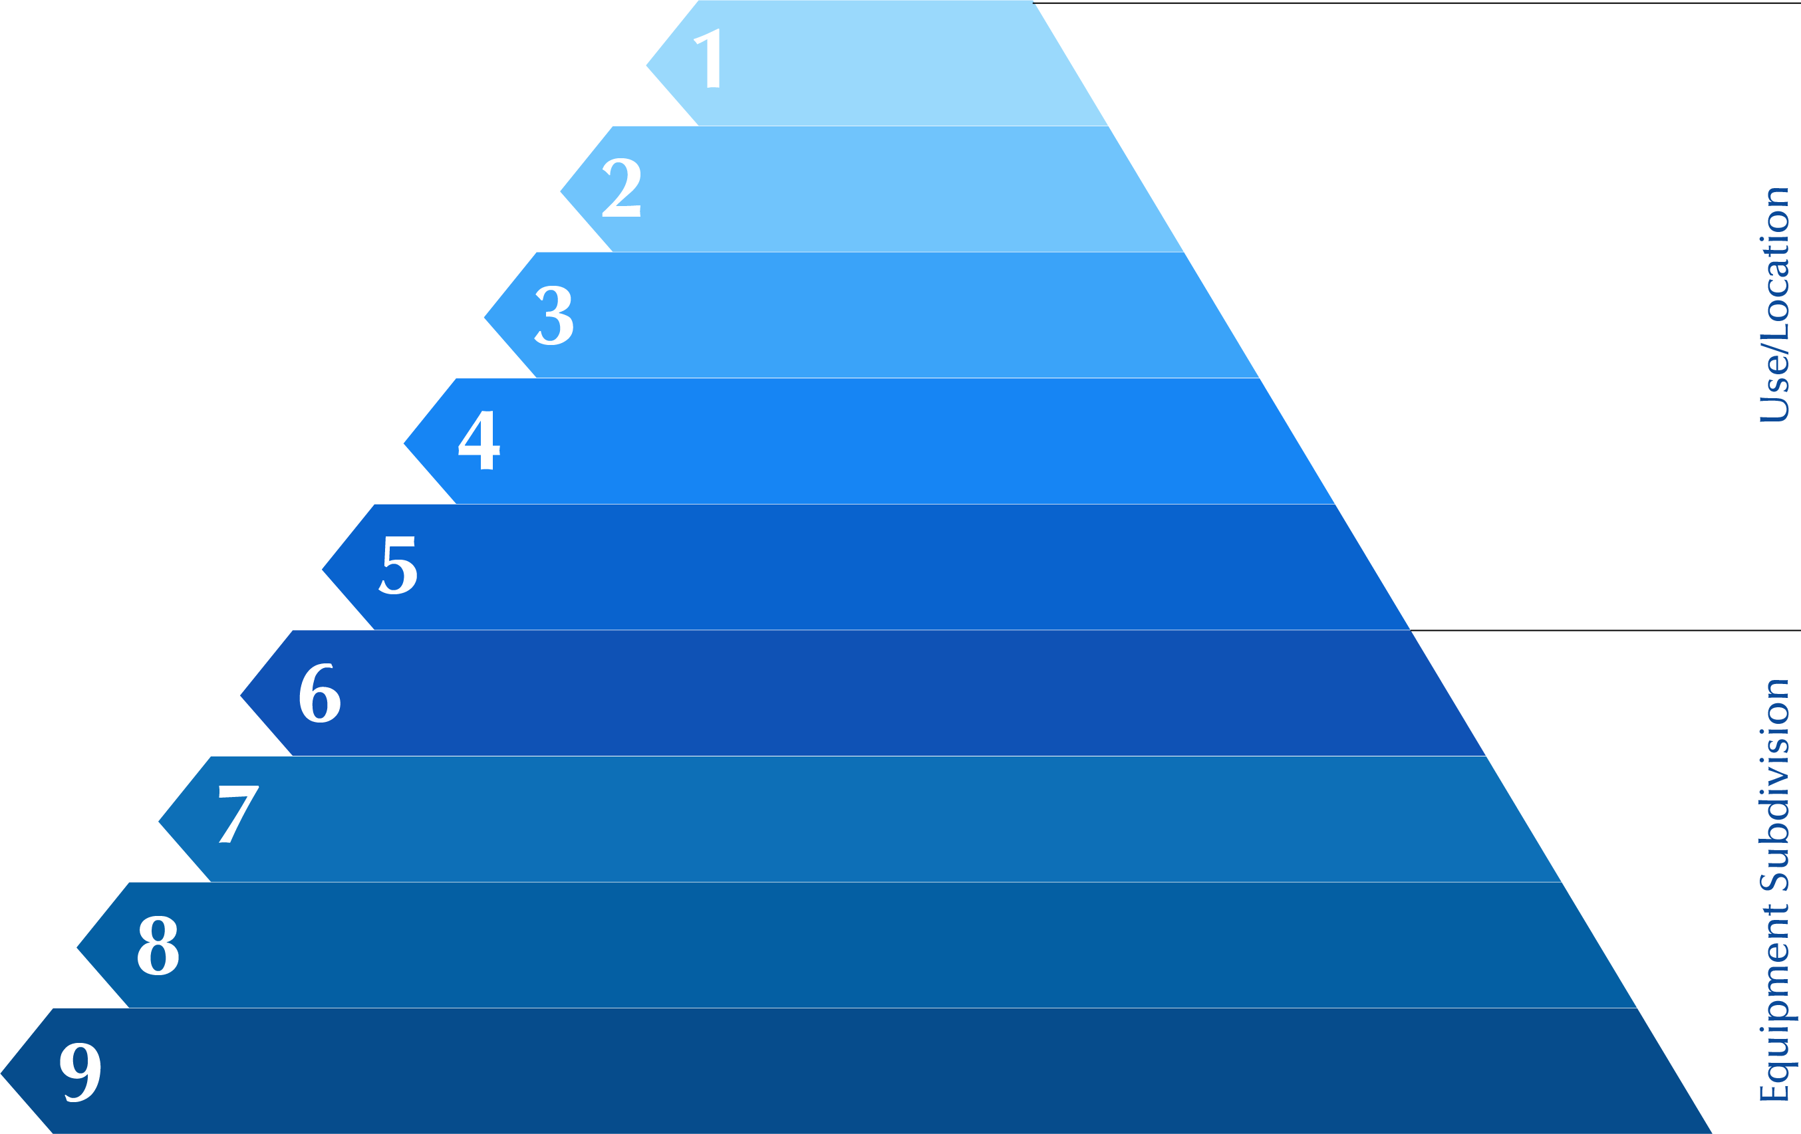
Industry Best Practices & Standards (ISO Standards) adopted at PiLog
Part 100
Part 110
Part 120
Part 130
Part 140
Data
Information
Knowledge
Intelligence
Wisdom
Provenance
Accuracy
Completeness
Industry
Business Category
Installation
ISO 14224-2016
Asset and Location Hierarchy Management
Plant/Unit
Section/System
Subunit
Equipment Unit
ISO 29002
Industrial Automation Systems & Integration
Exchange of characteristic data
Component/Maintainable Item
Part
www.piloggroup.com
Restricted Use

Slide 43



Key Industry Best Practices & Standards (ISO Standards) adopted at PiLog
ISO/IEC 11179 standard is an international ISO/IEC standard for representing metadata for an organization in a metadata registry (MDR) which is understandable and shareable.
Adopting to all 7 parts – Framework, Classification, Register Metamodel & Basic Attributes, Formulation of Data Definition, Naming & Identification Principles, Registration and Meta Model for Registration
Part 100
Part 110
Part 120
Part 130
Part 140
Meta Data Register (MDR)
(ISO / IEC 11179 Parts 1 – 7
Meta Data Registry Management)
Accuracy
ISO/IEC 19506 standard called Knowledge Discovery Metamodel is an ontology for describing software systems. Enabling the extractions such as data flows, control flows, call maps, architecture, database schemas, business rules/terms and the derivation of business processes
Primarily for legacy and existing systems security, compliance and modernization
Software Systems
(ISO/IEC 19506
Software Systems)
ISO 23081 standard is three-part technical specification defining meta data for records with emphasis given on principles in part 1, issues in concepts and implementation in part 2 and part 3 focusses on self assessment
Meta Data in Records Management
(ISO 23081
Records Management)
www.piloggroup.com
Restricted Use

Slide 44
Data Quality Dimensions
Data Completeness
The state or condition of having all the necessary data elements of the dataset completed
Data Accuracy
Data elements must have the right values and must be represented in a consistent and unambiguous form
Data Traceability
The capability of keeping track of a given data set or data elements or data values to a given degree
Data Consistency
The consistency ensures that any changes will bring the data set from one valid state to another. Any changes written to the data set must be valid according to all defined rules, including constraints, and any combination thereof
Data Timeliness
Data timeliness is at an appropriate or opportune moment in time
Data Availability
Data is available to the systems, users & processes at all times, without loosing its true value
Data Validity
It is the extent to which a data entity or element or value is well-founded and corresponds accurately to the real world
Material
Data Quality
Completeness
Accuracy
Consistency
Availability
Timeliness
Traceability
Vendor
Asset
Service
www.piloggroup.com
Restricted Use

Slide 45
Categorization & Classification for UNSPSC & NATO + Item Name
Discipline
Product Category
Sub-Category
Product Commodity
Material Class
UNSPSC Code+Desc
NATO & INC Code + Description
Electrical
Electrical Equipment And Components
Electrical Boxes And Enclosures
Electrical Boxes
Covers
Box, Junction
Cover, Conduit Outlet Body
39121332 Electrical Junction Box
39121304 Electrical Box Covers
452 TERMINAL BOX
5940 Lugs, Terminals, and Terminal Strips
19945 COVER,CONDUIT OUTLET
5975 Electrical Hardware and Supplies
Electrical Equipment And Components
Electrical Cables/Wires And Accessories
Cables
Cords
Cable, Jumper
Cord, Extension
39121441 Electrical Jumper Cable
26121536 Extension Cord
36364 JUMPER CABLE,BATTER
6150 Miscellaneous Electric Power and Distribution Equipment
485 CABLE ASSEMBLY,POWER,ELECTRICAL
6150 Miscellaneous Electric Power and Distribution Equipment
Electrical Equipment And Components
Electrical Protection And Controls
Switches
Relays
Switch, Selector
Relay, Control
39122217 Rotary Switch
39122331 Control Relay
5930 SWITCHES
5945 RELAYS AND SOLENOIDS
31445 RELAY,HYBRID
Electrical Equipment And Components
Power Generation And Distribution
Motors
Transformers
Motor, Geared
Transformer, Distribution
20101617 Gearmotors
39121001 Distribution Power Transformers
6105 MOTORS
32496 TRANSFORMER,POWER
6120 Transformers: Distribution and Power Station
www.piloggroup.com
Restricted Use

Slide 46




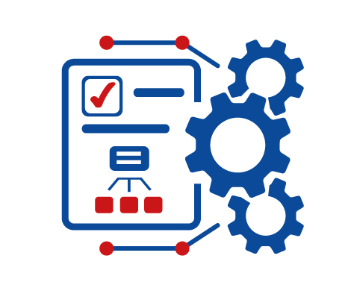

PiLog Lean & Agile Meta Data Management Simply your Data Needs with PiLog’s Lean Meta Data Management
360 Degree of Data Needs identified for enterprises sources on premise or on cloud
Understanding the need and relationship
Impact and risk management with continual monitoring of value
Where, how and who used list tracking & control
Technical Meta Data
including database schemas, mappings and code, transformations and quality checks
AI / ML
Powered for Augmented Data & Analytics
E.g., GENAI, CHATBOT Prescriptive Analytics
Business Meta Data
including glossary terms, governance processes, and application and business context metadata
Operational and infrastructure metadata
including run-time stats, time stamps, volume metrics, log information and system and location
Prescriptive Analytics
Perspective data intelligence helping to secure improve data quality
Utilization Meta Data
including that for user rating, comment and access-pattern
www.piloggroup.com
Restricted Use

Slide 47
Centralized Master Data management Use-Cases
www.piloggroup.com
Restricted Use

Slide 48


Data flow Mechanism for centralized Material Master
Company 1
Company 2
Company 3
Material master
Data Cleansing Tools
1 Group Level Data
Company 4
PiLog Data Strategy & Standardization
Centralized Material Master
Centralized Data Storage
Business Units/Companies
PiLog will create data collection template for centralized material master and circulate to all stakeholders and create a placeholder
All business units will extract required data fields as per template and /load to eRoom (common data storage platform)
PiLog will execute the data strategy for the centralized program and perform data standardization /harmonization / cleansing
PiLog will deploy Governance data tools to catalog and create centralized master data, all the data would be integrated with respective SAP / ERP systems
© PiLog Group
www.piloggroup.com

Slide 49



The effect of the challenges can be reduced by inducting Centralized Material Master Leading Practices
Material Master is the critical business information supporting the transactional and analytical operations of the enterprise
Leading Practices for Material Master Management & Governance
Strategy
People
Data
Process
Technology
Material Master Management Program is mature & understood throughout the business across group companies
Define mission, objectives and business value in order to justify and motivate the organization, provide focus, and measure progress
Identified sponsors have ownership, accountability, & buy-in for all aspects of Material Master improvements
A centralized Material Master Management support organization exists
Workforce spends time on value-add activities rather than searching for the correct data
Implementing data quality standards, tools and experience improves the business process efficiency
Centralized master data system provides robust frame work and unique business process.
Accurate data supported by automation drives & delivers faster decision making
Enterprise-wide Material Master Management processes are routinely reviewed for efficiencies and completeness and updated for optimization
Data governance reviews / approves changes to master data
Processes to avoid duplicate entries in place
Initiatives to eliminate conflicting systems of record
Integration for synchronization and/or harmonization across all master domains
Workflow and event monitoring in place for real-time approval processes
© PiLog Group
www.piloggroup.com

Slide 50
Centralized Material Master (Use-Case)
On-Premise
Users/Location
Repository Records
Master Data Dictionary (PPO)
On-Premise SAP System
CIL
CIL
KCM
PiLog’s Master Data Governance Solution
HZL
Web Services
STERLITE
KCM, HZL, STERLITE
VAL
TSPL
BALCO
VAL, TSPL, BALCO
SESA GOA
SESA GOA
Data Quality Review
Industry Standards
Descriptions
De-Duplication
VZI
VZI
© PiLog Group
www.piloggroup.com
New Record Creation, Change, Extend, Delete & Undelete

Slide 51
Vedanta Centralized Material Master
Vedanta Centralization Material Master – Existing Materials
Material Number | SAP CIL | SAP HZL
Old ERP Material Number | 100000021 | 100058924
Corporate Number | M1605101 | M1605101
SAP SESA GOA
10006789
M1605101
Old SAP Code | Instance | Plant | Old Short Text Description | Old Long Description | MDRM Number | New SAP Code | New Long Description
10002032 | CIL | 1000 | PUSHBTN;P/N:3SB5000-0AC01,SIEMENS | PUSH BUTTON; DIMENSIONS DIA 22 MM, CONTACT ARRANGEMENT 2NO, COLOR RED; P/N: 3SB5000-0AC01,Mnfr: SIEMENS | M100010140 | MEL391222210008 | PUSH BUTTON; CONTACT ARRANGEMENT: 2NO, COLOR: RED, DIMENSIONS: DIA 22 MM; MANUFACTURER PART NO: 3SB5000-0AC01, VENDOR: SIEMENS LTD
10001885 | VAL | 2000 | SIEMENS PUSH BUTTON-RED 3SB1400-0A | PUSH BUTTON;P/N: 3SB1400-0A,Mnfr: SIEMENS; COLOR: RED,POTENTIAL: 660 VAC, CURRENT: 10 A | M100010140 | MEL391222210008 | PUSH BUTTON; CONTACT ARRANGEMENT: 2NO, COLOR: RED, DIMENSIONS: DIA 22 MM; MANUFACTURER PART NO: 3SB5000-0AC01, VENDOR: SIEMENS LTD
www.piloggroup.com

Slide 52
Business Case (Benefits) of Group Rollout - Duplicates at Group Level
Company | Old Text | Centralized Catalogued Description
CIL | OIL, HYDRAULIC;TRADE NAME: MOBIL DTE MEDIUM, GRADE: ISO VG 46,CONTAINER TYPE: BARREL, CONTAINER CAPACITY: 208 L;MNFR: EXXON MOBIL; FFT: PHYSICAL FORM: LIQUID,VISCOSITY INDEX: 98, CST AT 40 DEG C: 44.5, CST AT 100DEG C: 6.9, POUR POINT, ASTM D 97: -15 DEG C, FLASHPOINT, ASTM D 92: 221 DEG C, DENSITY AT 15 DEG C, ASTMD 4052: 0.86 KG/L, TOST, ASTM D 943, HOURS TO 2 NN:3700, RUST PREVENTION, ASTM D 665: WATER: PASS,DISTILLED WATER: PASS, WATER SEPERABILITY, ASTM D1401,MIN. TO 3 ML EMULSION AT 54 DEG C: 15, COPPERSTRIP CORROSION, ASTM D 130,3 HOURS AT 121 DEG C: 1B,FOAM TEST, ASTM D 892, SEQ I TENDENCY/STABILITY: 50/0ML/ML | OIL, LUBRICATING; GRADE: ISO VG 46, VISCOSITY RATING: 44.5 CST AT 40 DEGC, FLASH POINT: 221DEGC, POUR POINT: -15DEGC, STANDARD: DIN 51515-1:2010-02, VISCOSITY INDEX: 98, DENSITY: 860 KG/M3 AT 15 DEGC; BRAND NAME:MOBIL DTE MEDIUM
STERLITE | PART NAME: OIL,MEDIUM,DTE,MAKE: MOBIL,PROPERTIES: ISO VISCOSITY,GRADE 46 CST AT 40 DEG.C,44.5 CST AT 100 DEG.C,6.9 VISCOSITY INDEX-ASTM D 2270-98 DENSITY (IP 365 ) AT 15 DEG.C,0.867 G/ML POUR POINT (ASTM D 97),15 DEG.C,FLASH POINT (ASTM D 92),221 DEG.C,FOR BEARING LUBRICATION,FOR MOTOR,MAKE: ABB LTD
SESA | OIL,HYDRAULIC,VG46 HIGH VISCOSITY
KCM | OIL,TYPE:HYDRAULIC,APPLICATION:CIRCULATING,GRADE:ISO VG 46,CONTAINER:210 L(DRUM)
www.piloggroup.com

Slide 53









Centralized Material Master Data Management – Value Proposition for El Sewedy
Decentralized Material Master
Group Level Business Impact
Value Proposition - Opportunities
Localized procurement strategy
Globalized procurement strategy
Improve Spend Visibility
Reduce Working Capital
High critical spares inventory
Optimize critical spares inventory
Reduce time to decision
Reduce
MDM effort
Individually stored excess materials
Optimized central storage for high volume high critical items
Non usage materials as scrap
Utilization of excess inventory by other business units as required
Improve Standardization
Improve Consolidated Procurement
Less margin to reduce working capital
Competitive working capital with industry trends
Reduce
Re-work
Increase Demand Visibility
Emergency stock outs
No stock out situation
© PiLog Group
www.piloggroup.com

Slide 54
Data Governance Solution Overview
www.piloggroup.com
Restricted Use

Slide 55




Data Governance Solution
PiLog’s Data Quality Governance applies the principles of lean management to the governance of data within organizations. It focuses on ensuring that data-related processes are efficient, effective, and aligned with the organization's goals while minimizing time. Primarily Small and Medium businesses can benefit from this lean Architecture as well as extend it to Enterprise Level.
The Data Governance Concept Promotes Three Significant Pillars.
Simple
Agile
Swift
Preconfigured & Augmented Business & Data Content
Shift Left User Engagement models
Scalable Solutions & Architecture
Enables Multi Domain,
Tenant & Language
ERP / COTs agnostic Data
Mart & Interoperability
Deployed within few
weeks with Zero Flaws
Modular deployment
with ease
Measure & Realize Value
from Data Maturity &
Process Efficiencies
Plug and Play though
enabled on Cloud
Minimal Change
Management
Zero Disruption &
Maintenance
This conceptual approach is forged into a powerful product suite that has a complete set of tools to serve the event and data driven digital transformation that contemporary enterprises seek.
Strictly Confidential

Slide 56

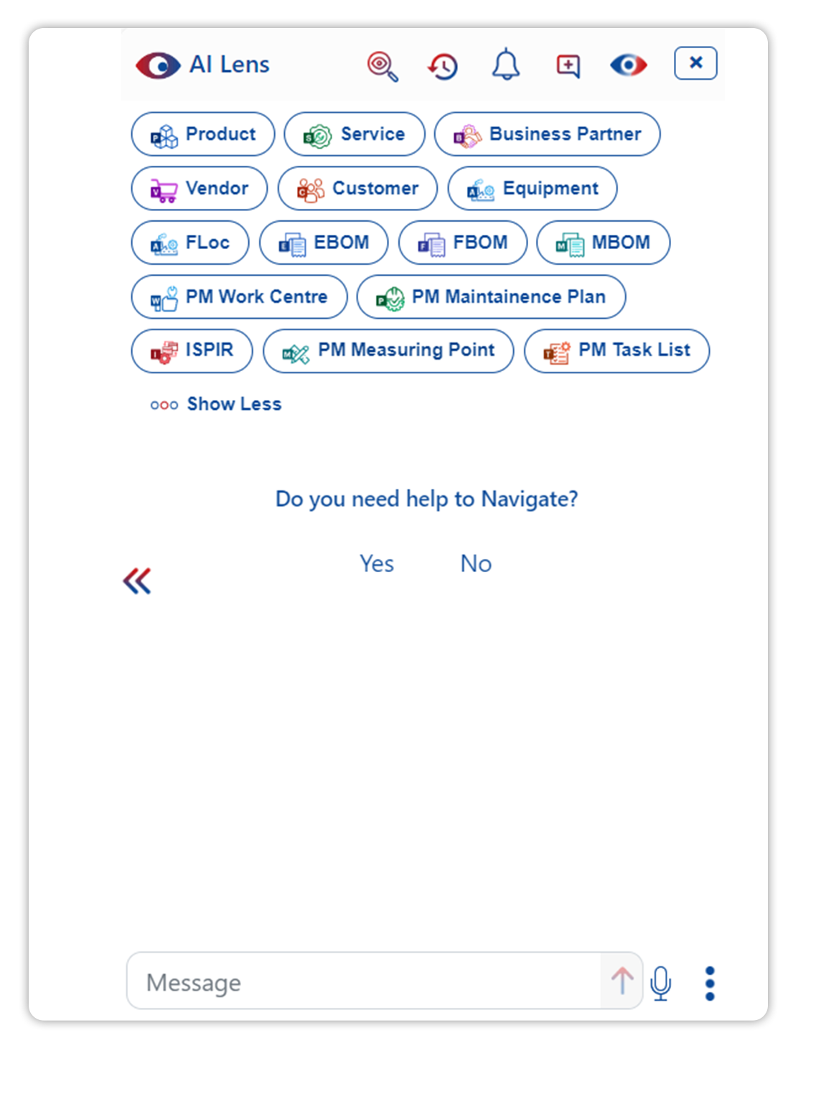
AI Lens
AI Lens is PiLog’s copilot, a virtual assistant embedded in Data Governance Solution Product Suite​
An application of ‘Conversational AI’ that simulates human-like conversations engages in answering queries, empowering users with augmented processes, guides the users as subject matter expert, provides insights on specific data points, showcases the analytics, pivoting the data, transverses the processes as per the context, domain & business specific configuration​s
AI Lens is Conceived & Designed​
PiLog’s proprietary solution
Scaled-down LLM model​
Generative AI approach​
Ethical & Pragmatic model
NLP model​
Fully configurable​
Continuously trained contextually​
Knowledge base​ - Taxonomies & Repositories
Augmented Data Quality
Simple & Extended analytics​
Real-time & staged integration with SAP or Oracle or APIs​
Guide as Subject Matter Expert​
Qualitative validations
Process augmentation
www.piloggroup.com
Strictly Confidential
56

Slide 57
Recommended Data Governance Strategy…
Board of Directors
Executive Management
Center of Excellence
Operational Management
Process Owners (SME)
Business Users
Stewards
Process Drivers
Functional Expertise
Business Users
End Users
Leadership Committee
Data Governance
Data Architecture Modeling & Design
Database Management
Data Security Management
Reference & Master Data Management
Data Warehousing & Business Intelligence Management
Documents & Content Management
Meta Data Management
Data Quality Management
Data Integration & Interoperability
Technology
Processes
People
www.piloggroup.com

Slide 58
Master Data Creation Process (Material/Asset)
Requestor
Approver
Steward
Manager
Search
Record Found
No
CR – Create
(New Record)
Populate Characteristics
Review, Check, Process
Review, Check, Process
Review, Check, Process
Yes
Populate Part No, Reference, Document, ERP
No
Use it
Duplicate
Auto-Generate Descriptions
Replicate
Oracle ERP
Yes
Review & Process
Delete
Return

Slide 59




























PiLog’s Data Governance Solution
Comprehensive data quality & governance solution powered by AI
Single or Mass Process (Parallel & Sequential WF)
Multi-Domain &
Multi-Lingual
Predefined Rules &
Processes
SAP Certified
S4 & RISE Integration
SAP Store
Cloud Ready
CREATE
AI Agents
ISO Content + Industry-Proven Practices
CHANGE
SIMPLE – AGILE – SWIFT
DATA
GOVERNANCE
EXTEND
DELETE
UNDELETE
BLOCK
UNBLOCK
MERGE
Requestor
Approver
Steward
Manager
LINK / REF
FLOC + Asset
Service
Material
iFAR
iSPIR
eBoM
Work Center
fBOM
mBoM
Manufacturing Industries
Maintenance Plan
MSS
Measure-Point
Task-List
Vendor
Customer
Employee
Leave
Incident
www.piloggroup.com
Restricted Use
Notes:
Data Governance for multi domain master and meta data enabling GOLDEN RECORD MANAGEMENT

Slide 60



Master Data Governance – Federated Model
Business Users
From Plants/Business
Regional/Functional/Plant Level
Center of Excellence (COE)
Shared Services Cell
Center of Excellence (COE)
Master Data Governance
Solution
ERP Systems
Oracle Fusion
Materials
Assets
Services
Master Data is requested by business users, where as Quality checks & approvals can also be done by Local team (COE)
Business users have authority to only request, ultimate authority to approve the change is with the distributed COE teams
Central team can share the workload with the Local COE team to serve the requests from various users from all businesses
Central team will work in sync with the Local teams, however corporate level administration will be with only the Central team
High usability of the data records, instead of creation, existing records can be extended or reused
Central team can perform audits & checks on the data quality on regular basis, can enforce the local team to adhere to the SLAs
www.piloggroup.com

Slide 61

Master Data Processes
Create
Change
Oracle Fusion
Extend
Delete*
Undelete*
Block#
Unblock#
Requestor
Approver
Steward
Manager
Role | Activity | Location
Requestor | Search, Initiate CR, Populate the values, Governance Checks, Process | Plant/Business Unit
Approver | Review CR details, Corrective Actions, Governance Checks, Process | Plant/Business Unit
Steward | Review CR details, Governance Checks, Process | Center of Excellence
Manager | Review CR details, Governance Checks, Process for Replication | Center of Excellence
www.piloggroup.com

Slide 62
Implementation Approach
Plan
& Prepare
Business Analysis &
Blueprint
Configure& Realize
Deploy & Test
Transform & Validate (Data)
Go-Live & Hyper Care Support
Steady State Support
Kick-off Meeting Project.
Project Governance
Team setup
Project Charter
Business Requirements
VPN Access, Access to Customer Network.
Infra readiness
Database & PiLog Suite Servers
BBP Document (AS IS TO BE, GAP)
SAP KDS Fields
(Template will be shared by PiLog)
Sign-Off BBP from specific/all the respective stakeholders
DEV & Quality Environment readiness & Deployment
Setup, Create, and Configure Oracle database instance for DQG Quality System
Migrate Group 1 data into DQG schema for Development
Business Rules, Validations, Workflows etc. Configuration
Configure the Create, Change, Interfaces for dev & testing
Full Cycle Test
Performance Test (Stress & Benchmarking)
Interface Test
Integration Testing (SIT)
Create the DQG Schema in Prod. System
DQG to ERP Interface testing in Production
Cutover planning
Base Tables Data
Operational Tables Data
Data Access Layer
Dictionary Tables
Configuration Tables Data
,Roles & Authorizations
Integration, Functional, Performance & Full Cycle Testing (Prod)
Mock
Go Live Decisions
Data Loads Validation
Hypercare Support
Techno-Functional as per SLAs
Value AMS for CI
Production Support post Go Live
Identify any customizations or changes for further improvements
Change
Management & Training
Communication Plan.
Change Governance
Training Plan
Events Plan
Internal & External Communication.
Train the Trainer Program Management
Change Mgmt. Events
Measurements of Improvement
Change Impacts
Corrective & Preventive Measures
Closure Report
www.piloggroup.com
Restricted Use

Slide 63
PiLog Implementation Timelines
1) Plan & Prepare
Execution Plan Completed
2 Weeks
Realization Complete
2) Business Analysis & Blueprint
UAT & SIT
Completed
2 Weeks
Production
Ready
Project
kick off
3) Configure & Realize
2 to 4 Weeks
4) Deploy & Test
Business Design
Complete
2 Weeks
Hypercare Support
Business Continuity
& Sustenance
5) Transform & Validate
1 Week
6) Change Management & Training
Data
Cut-Over
1 Week
7) Go-Live & Support
2 Weeks
www.piloggroup.com
Restricted Use

Slide 64
Proposed Implementation Idle Timelines
M0 | M1 | M2 | M3 | M4 | M5 | M6 | M7 | M8 | M9
Plan & Prepare
Business Analysis & Blueprint
Configure & Realize
Deploy & Test
Transform & Validate
Change Management & Training
Go-Live & Support
Hypercare
Support
Duration (Months – 8 to 9)
© PiLog Group
PiLog
www.piloggroup.com
Restricted Use

Slide 65
AI Lens with AI Agents (DQG Co-Pilot)
“Redefining Master Data Management with AI”
www.piloggroup.com
Restricted Use

Slide 66
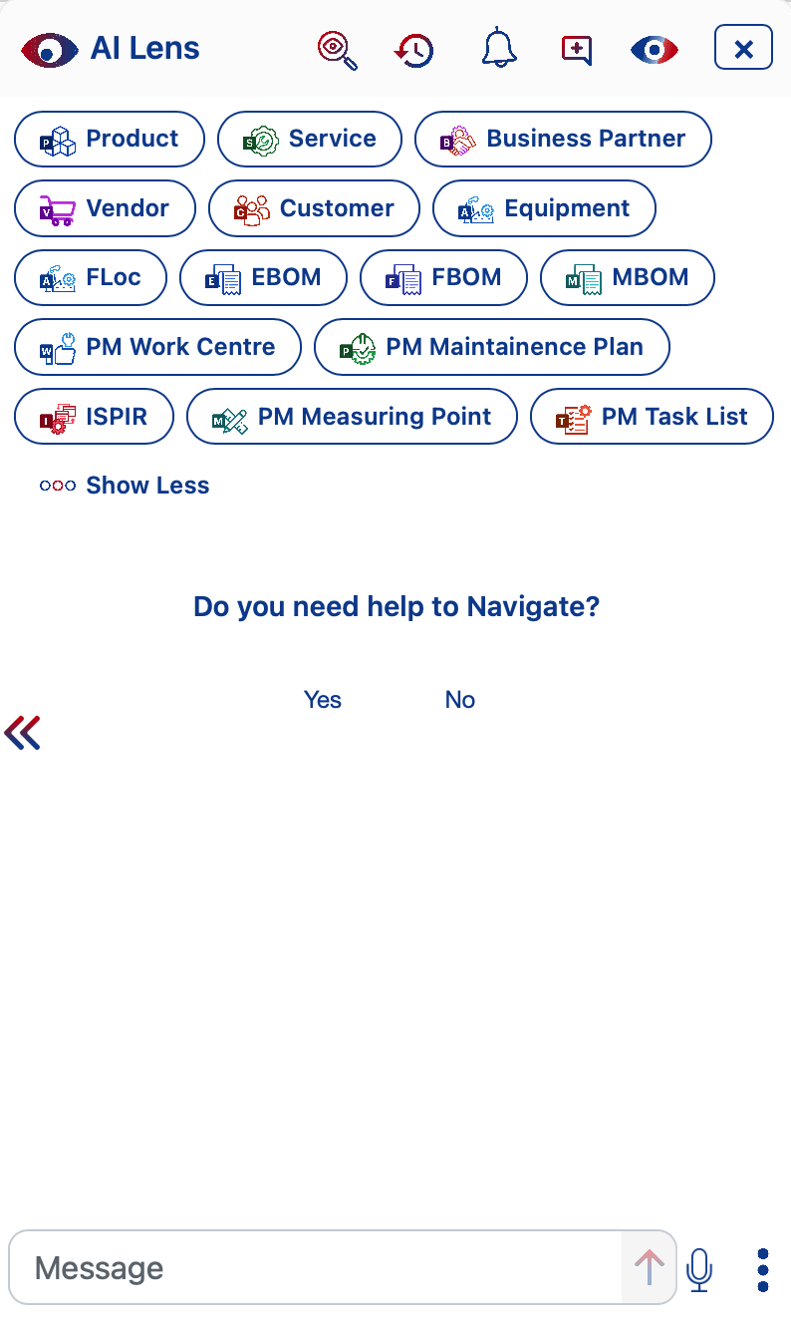

AI Lens is PiLog’s copilot, a virtual assistant embedded in DQG Product Suite
AI Lens is conceived & designed
Conversational AI
Scaled-down LLM & LAM Model
Generative AI Approach
Trained Contextually
NLP Model
Knowledge base
Augmented AI
Configurable features
Simple & Extended Analytics
Real-time & Staged Integration with SAP or Non-SAP or APIs
Guide as Subject Matter Expert
Qualitative Validations & more
The Conversational AI is application of Artificial Intelligence that simulates human-like conversations engaged in answering queries, guides the users as subject matter expert, provides insights on specific data points, showcases the analytics, pivoting the data, transverses the processes as per the personalized configuration
AI Agents
DH007 - Data Harmonization Agent
DE007 - Data Extraction Agent
QC007 - Data Quality Check
SR007 - iSPIR Extraction Process
www.piloggroup.com
Restricted Use

Slide 67
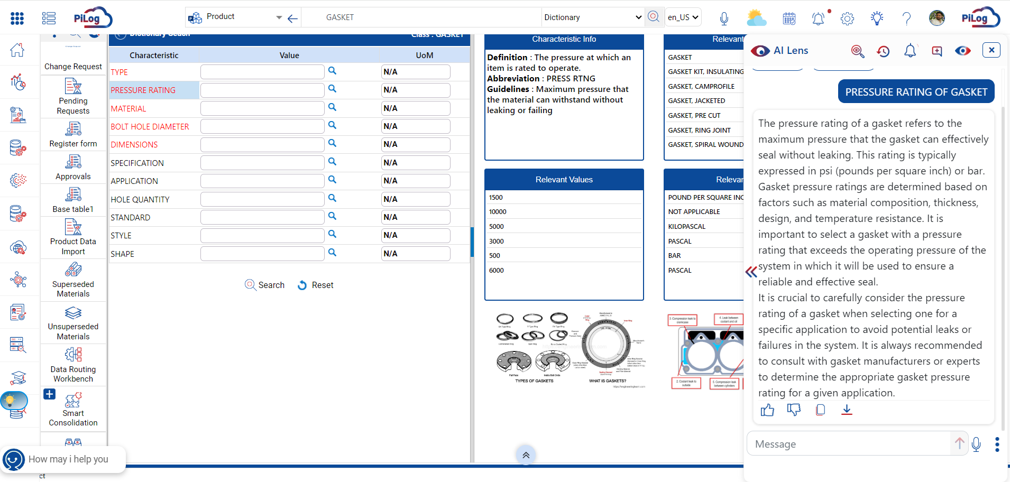
Use Case 1 - Product - Knowledge Base (1/4)
Invoking AI Lens on the Characteristic name selection Eg: PRESSURE RATING of GASKET
www.piloggroup.com
Restricted Use

Slide 68
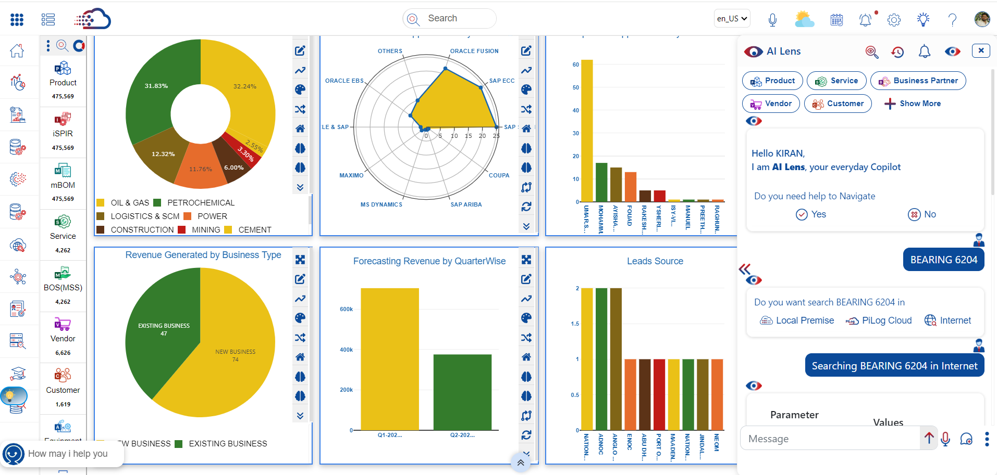
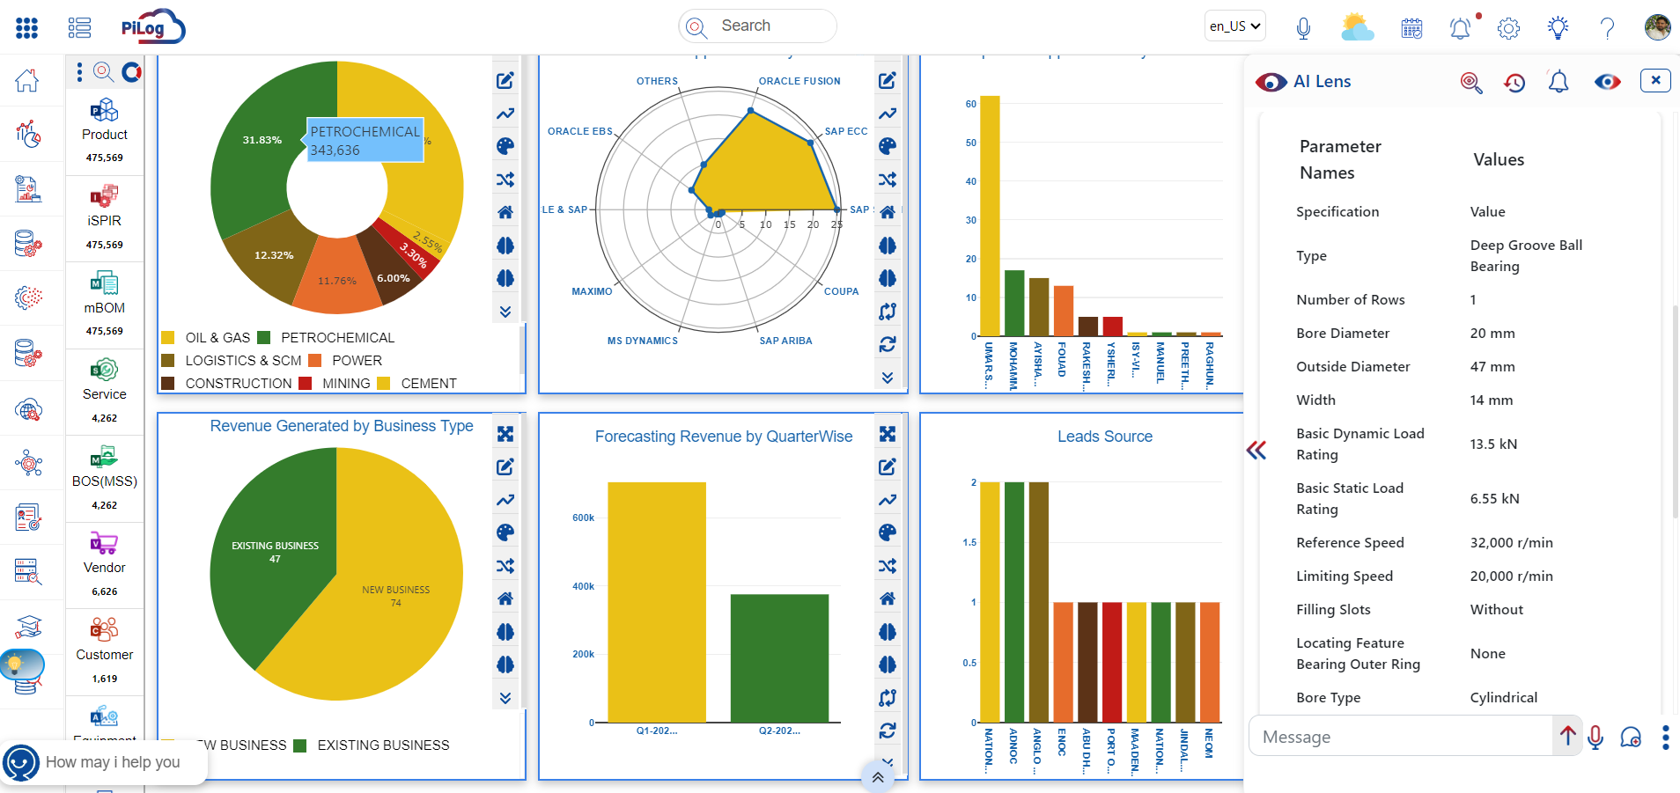
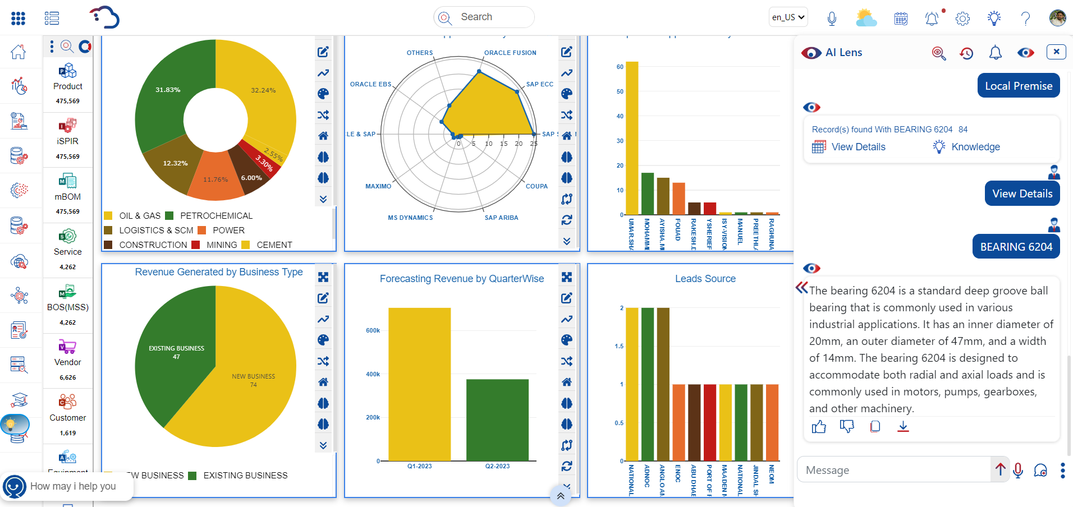
Use Case 1 - Knowledge Base (2/4)
You can search any description on ‘Local Premise’ or ‘PiLog Cloud’ or ‘Internet’
Searching for ‘BEARING 6204’ on Internet & ‘View Details’ on Local Premise
www.piloggroup.com
Restricted Use

Slide 69
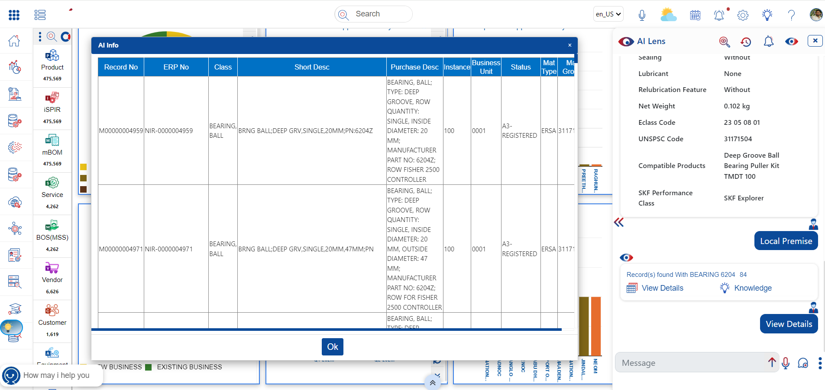
Use Case 1 - Knowledge Base (3/4)
‘View Details’ on Local Premise
www.piloggroup.com
Restricted Use

Slide 70
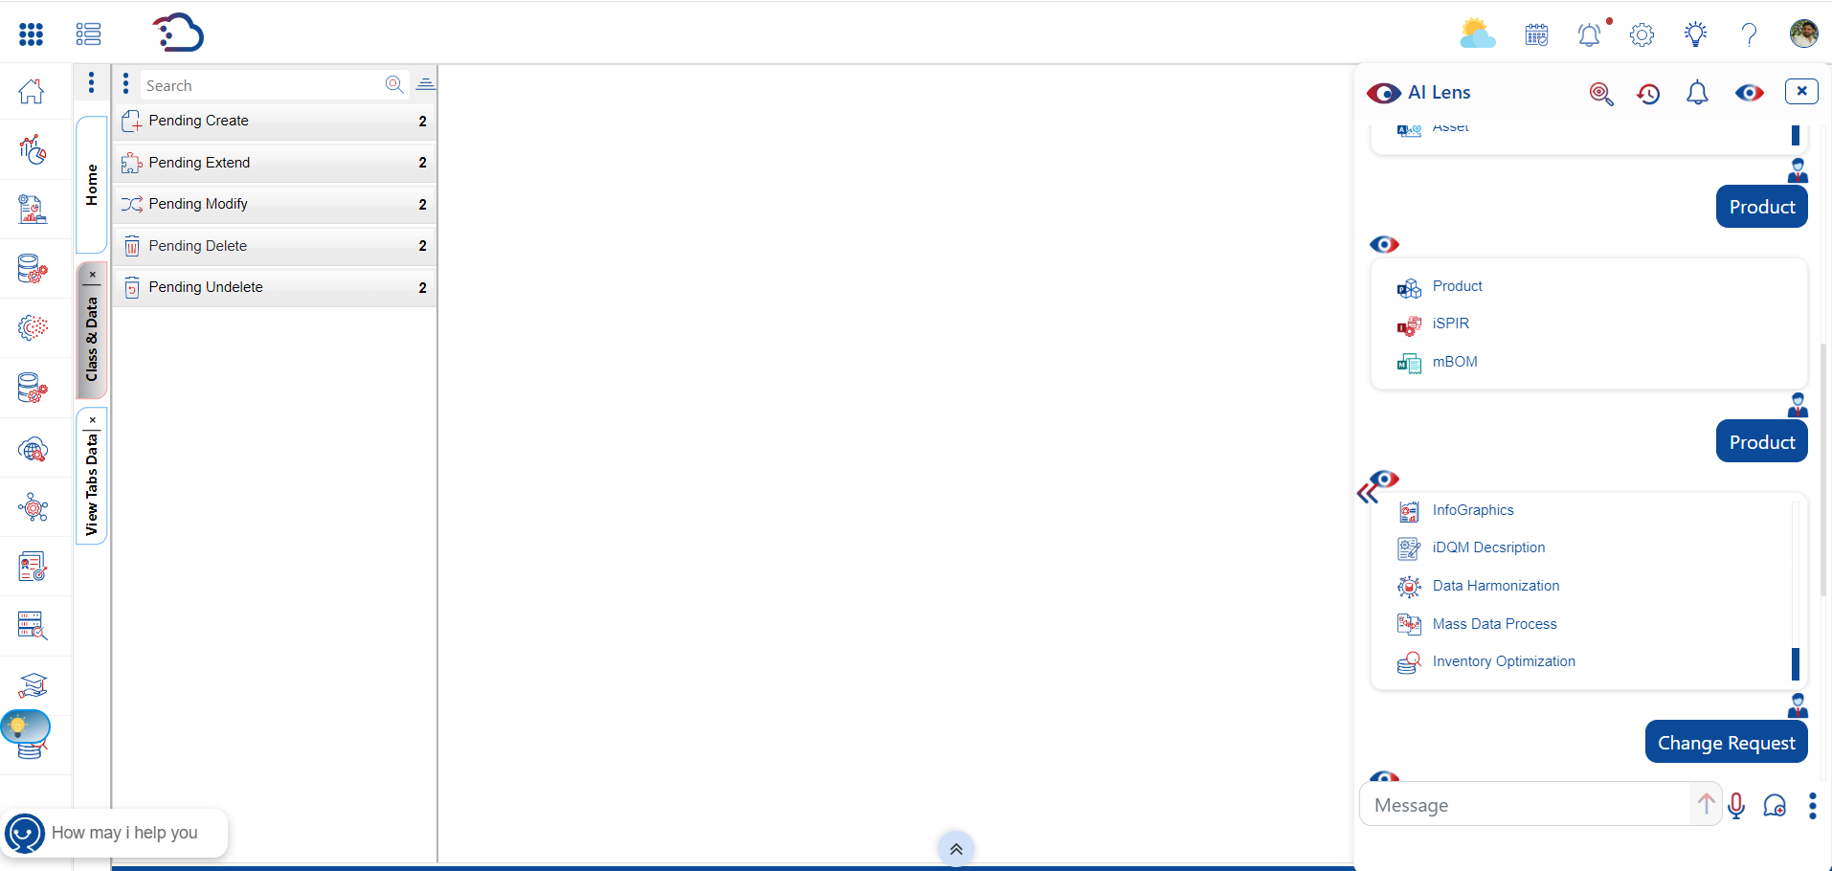
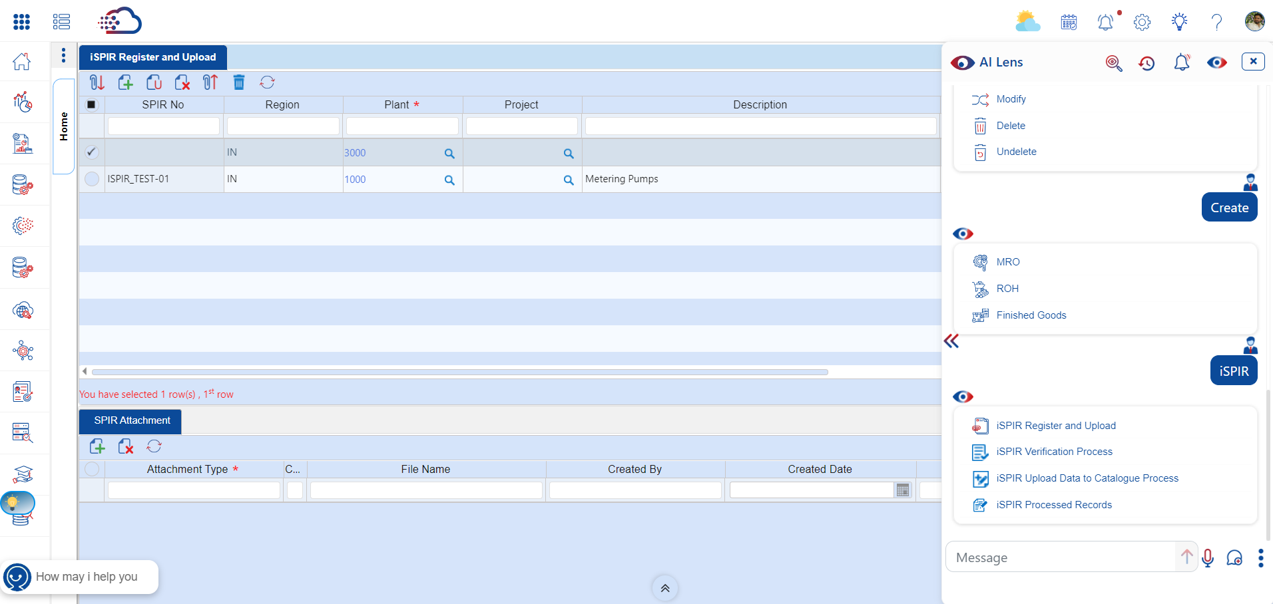
Use Case 1 - Knowledge Base (4/4)
‘Navigation’ across the application through AI Lens
www.piloggroup.com
Restricted Use

Slide 71
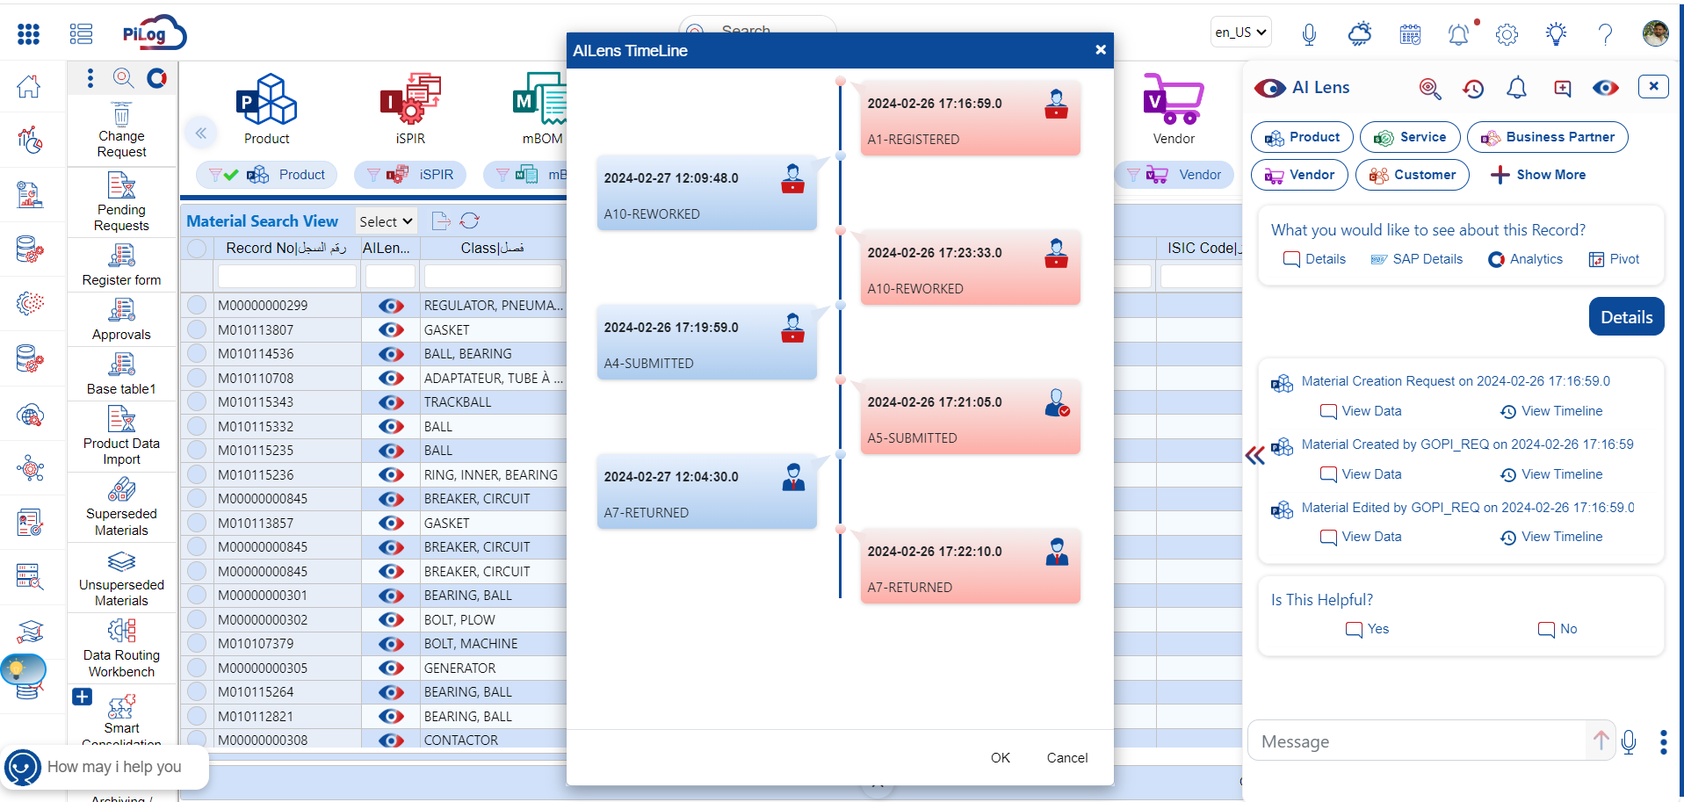
Use Case 2 - Status, Timelines, Progress, Navigation, Research, etc.
Timelines of each request/record using AI Lens
Highlighting the Duplicates based upon AI Lens Output
www.piloggroup.com
Restricted Use

Slide 72
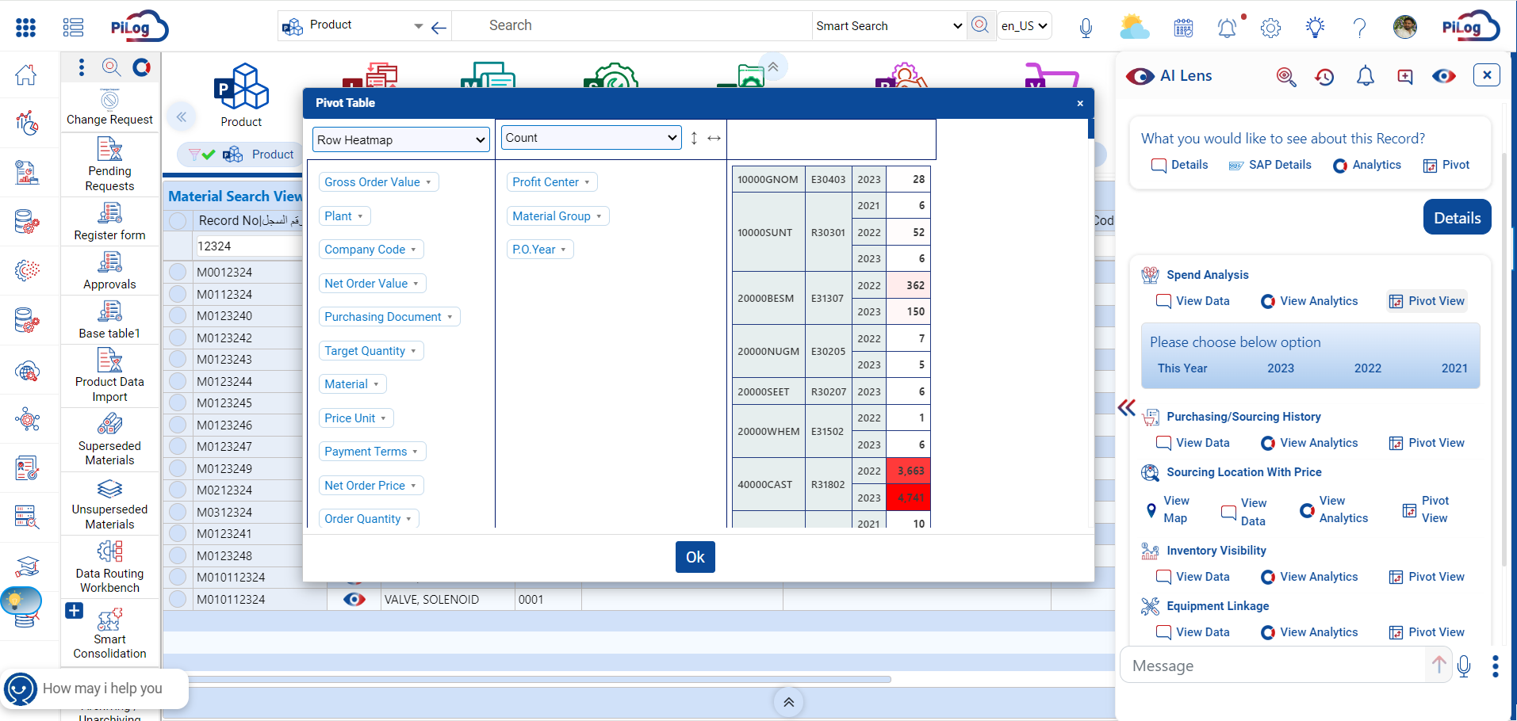
Use Case 3 - Analytics (Pivot Table)
A Pivot Table lets you rotate the data and look at it from different Angles or perspectives
www.piloggroup.com
Restricted Use

Slide 73
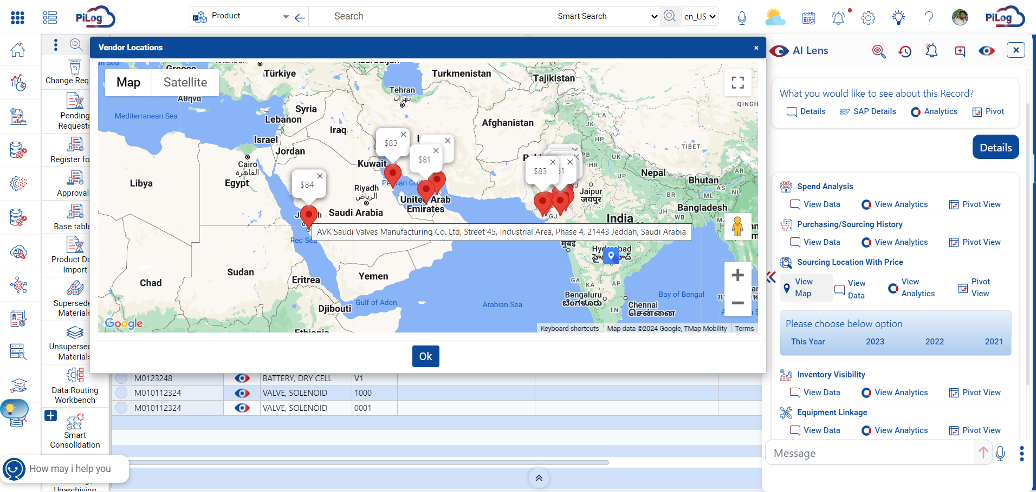
Use Case 4 - Sourcing Location with Price (approx.)
Highlighting Locations with Price details using AI Lens
www.piloggroup.com
Restricted Use

Slide 74
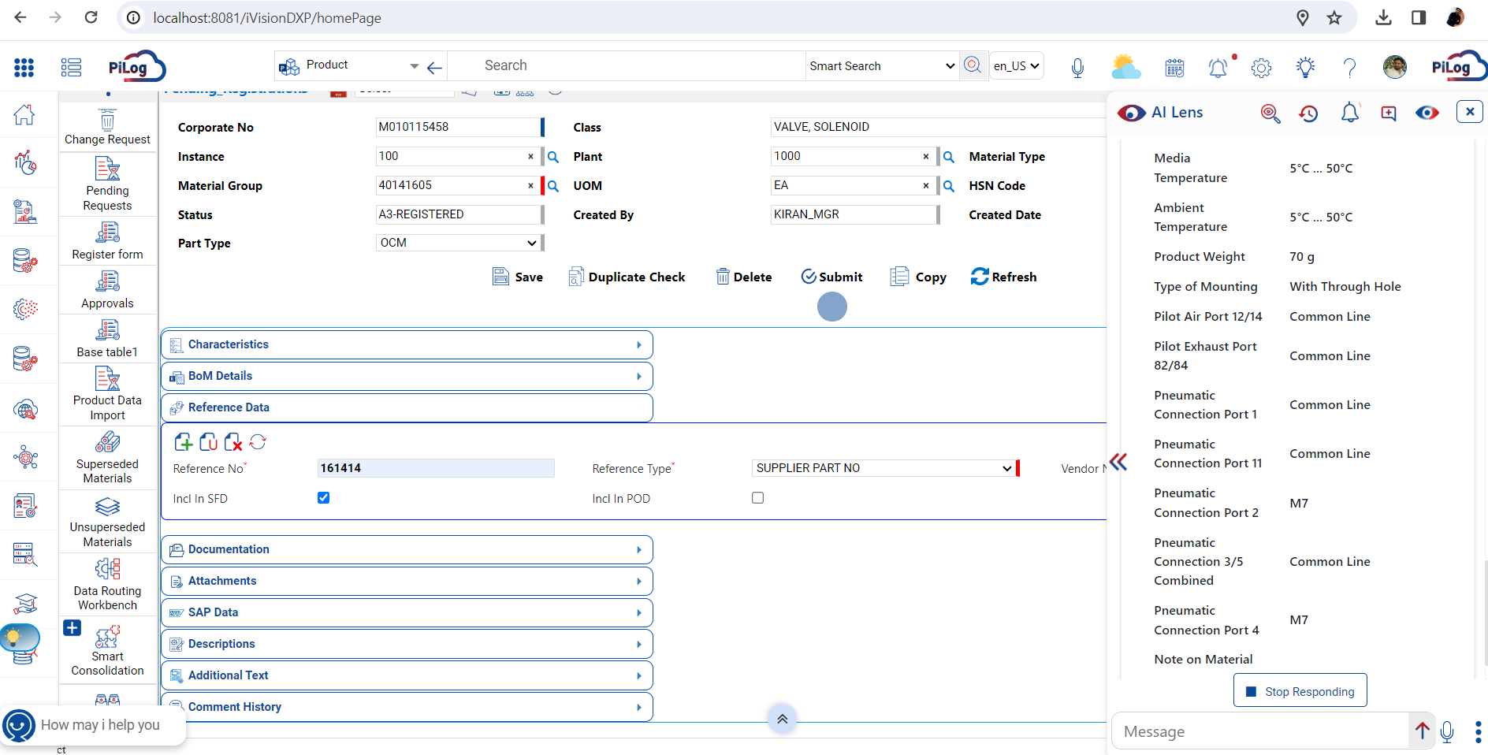
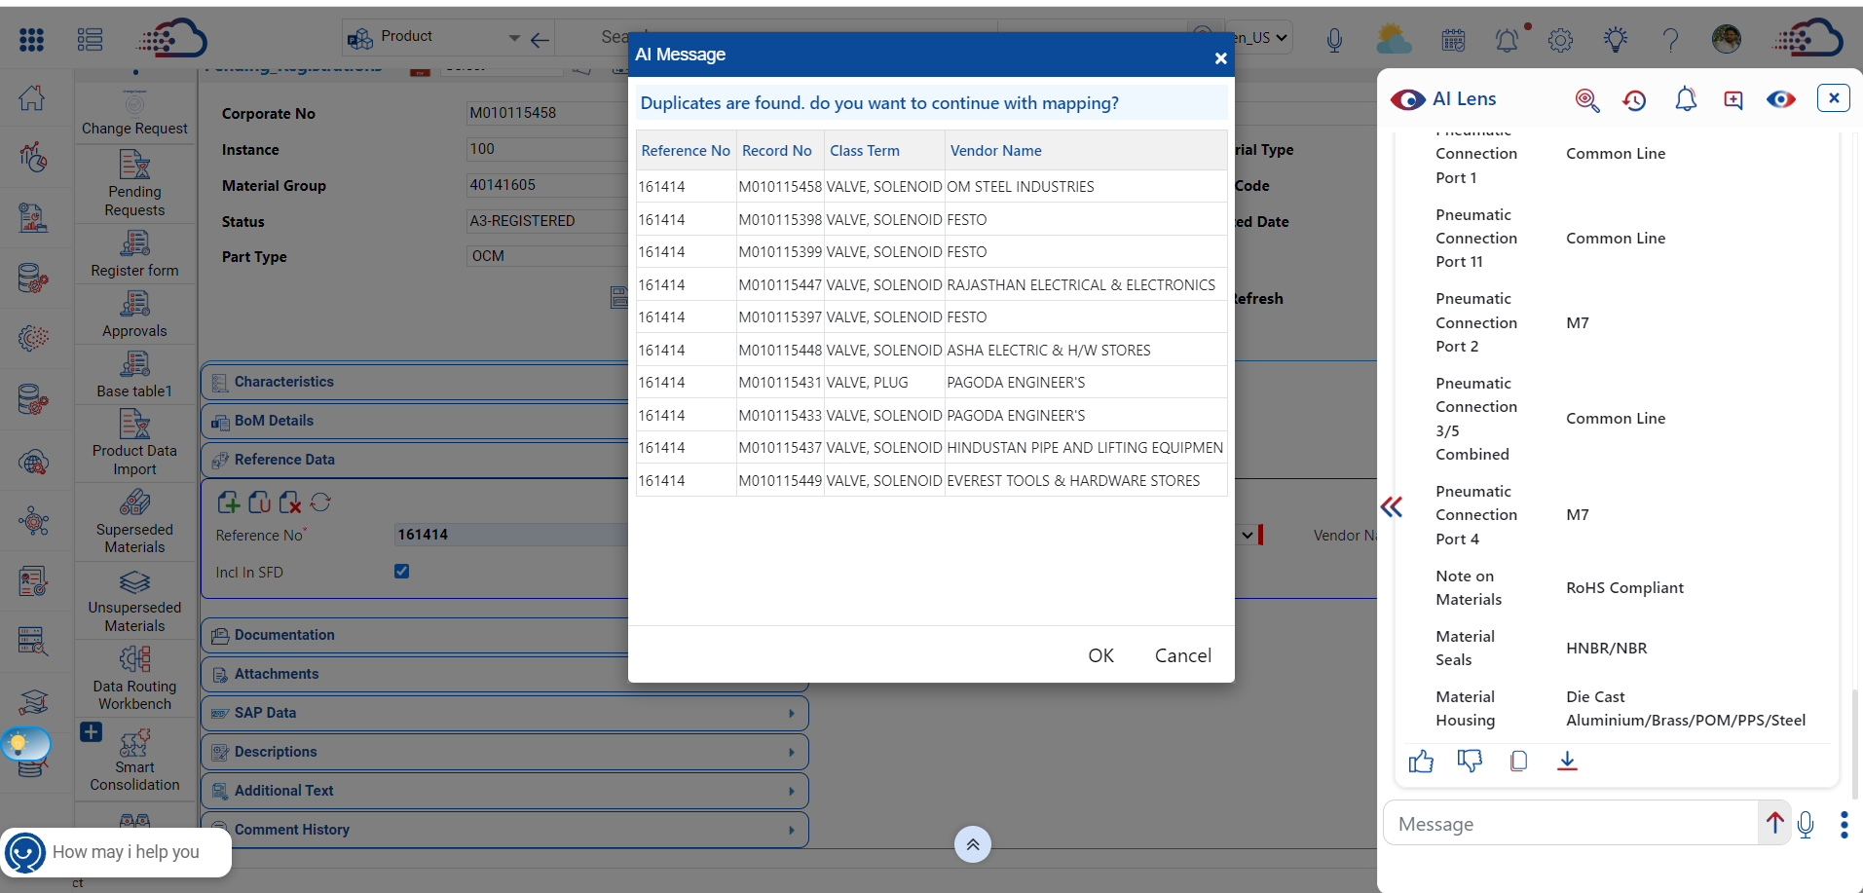
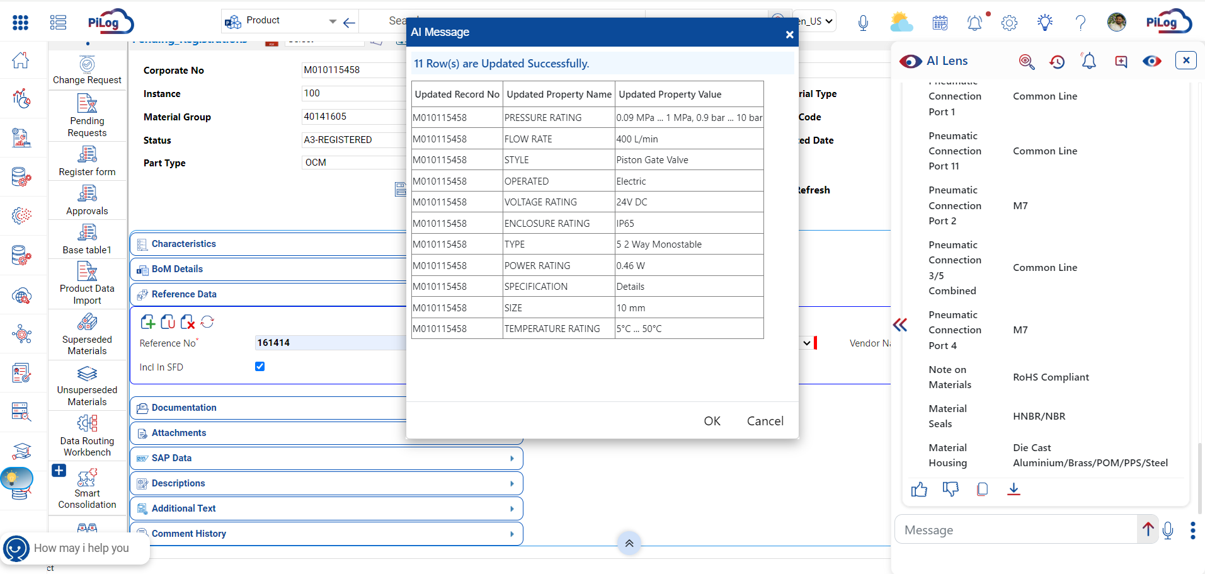
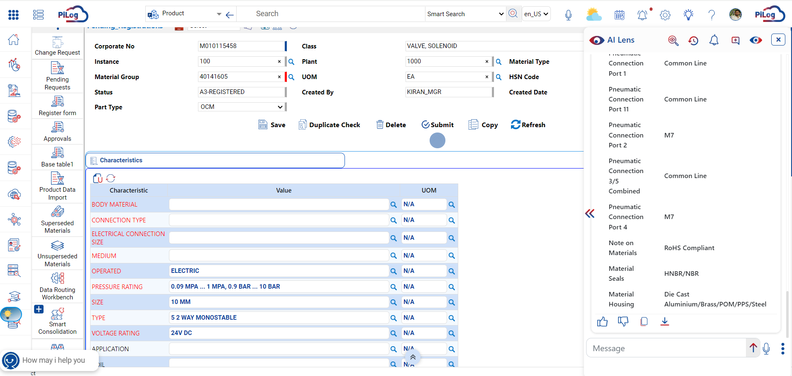
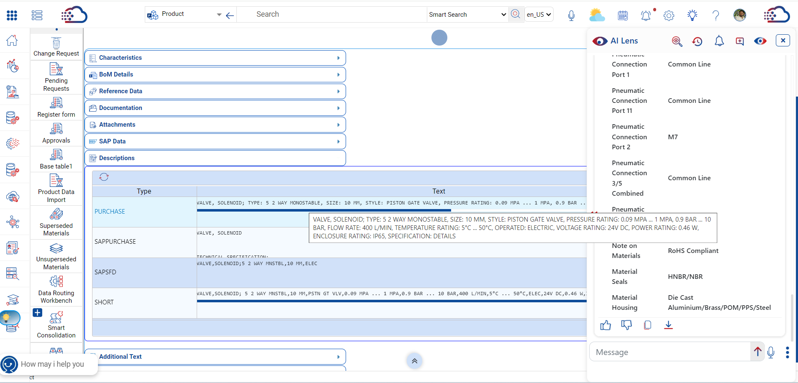
Use Case 5 - Data Science Services
Product Creation - Data Science API is used to enrich the relevant data based on the Reference Number from Manufacturing Website
www.piloggroup.com
Restricted Use

Slide 75
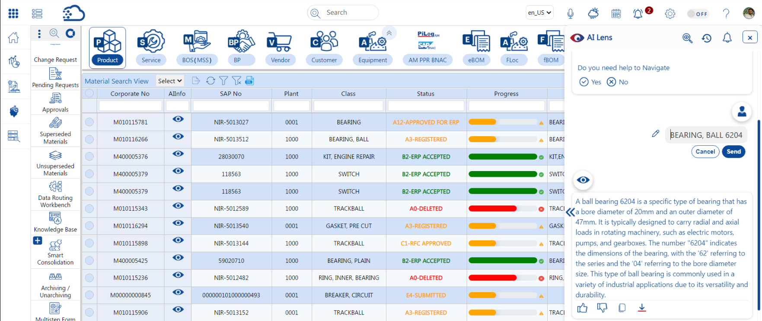
Use Case 6 - AI Lens Input Data Edit
After entering input data into the AI Lens, an option to edit the entered input has been added
www.piloggroup.com
Restricted Use

Slide 76
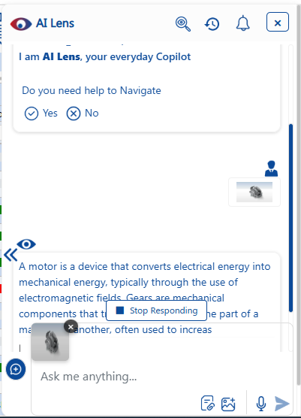
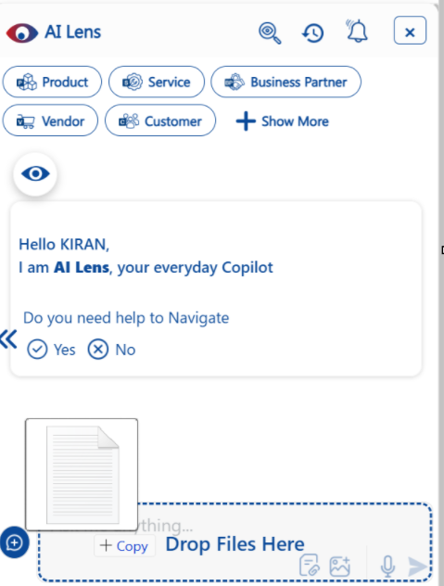
Use Case 7 - Drag and Drop
Drag and drop image and text files
www.piloggroup.com
Restricted Use

Slide 77
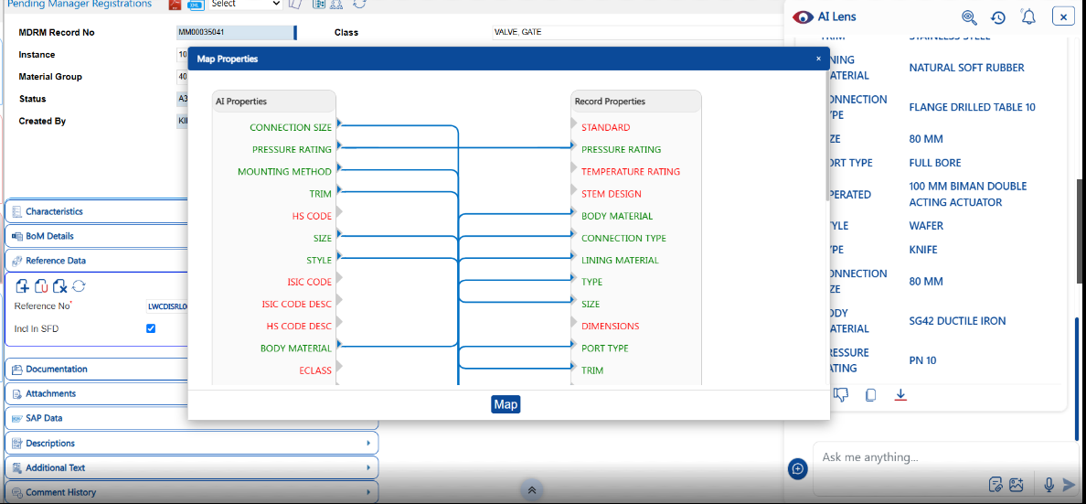
Use Case 8 - Manual/Auto Mapping
The mapping is provided automatically
www.piloggroup.com
Restricted Use

Slide 78
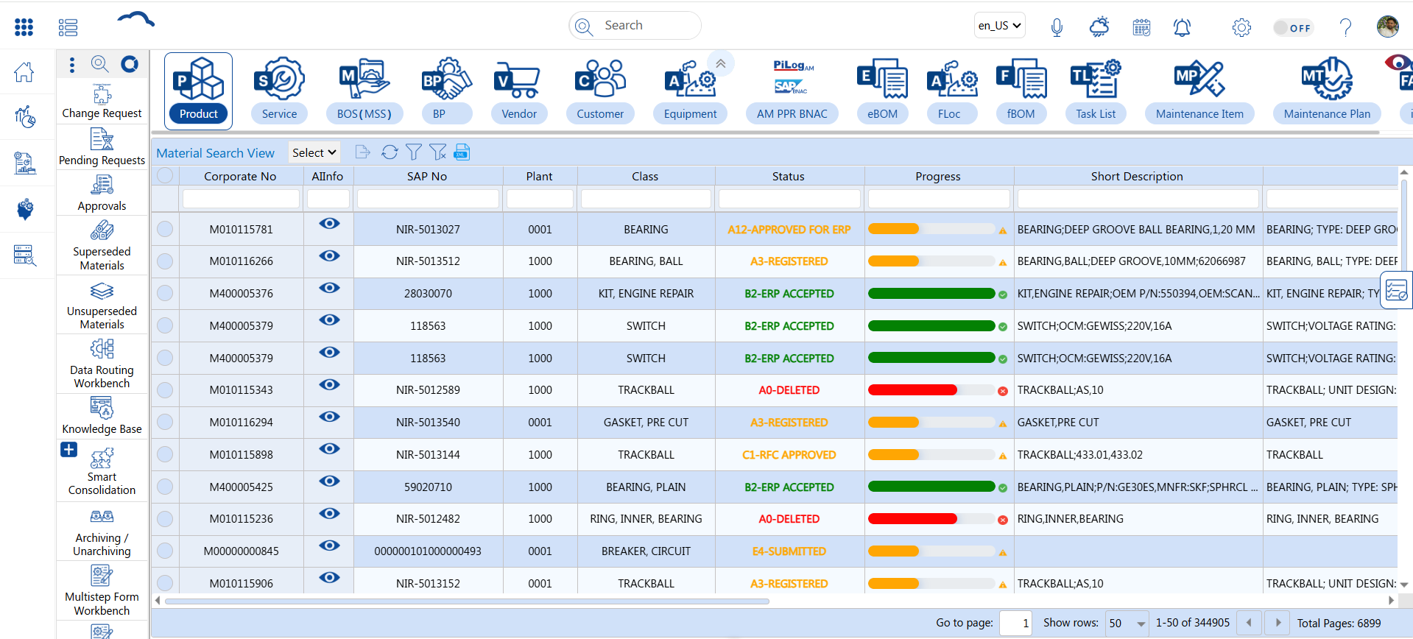
Use Case 9 - Status & Progress
Fiori status colours and a progress bar have been added to the grids
www.piloggroup.com
Restricted Use

Slide 79
UI5 Theme
“Fiori Look & Feel using UI5 Theme with enhanced User Experience”
www.piloggroup.com
Restricted Use

Slide 80
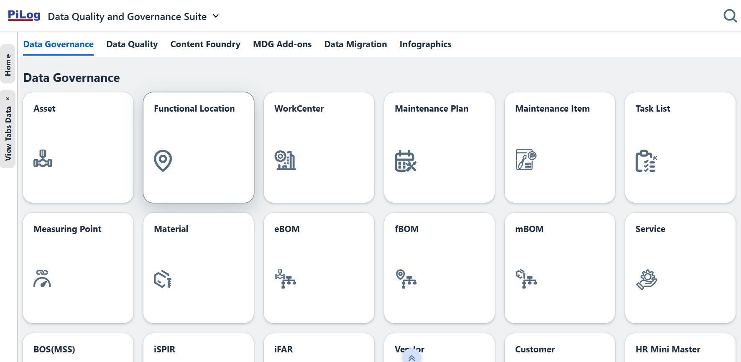
UI5 Theme
Tiles highlighting the Objects in DQG, enhanced user friendly screens as of SAP Fiori Look & Feel
www.piloggroup.com
Restricted Use

Slide 81
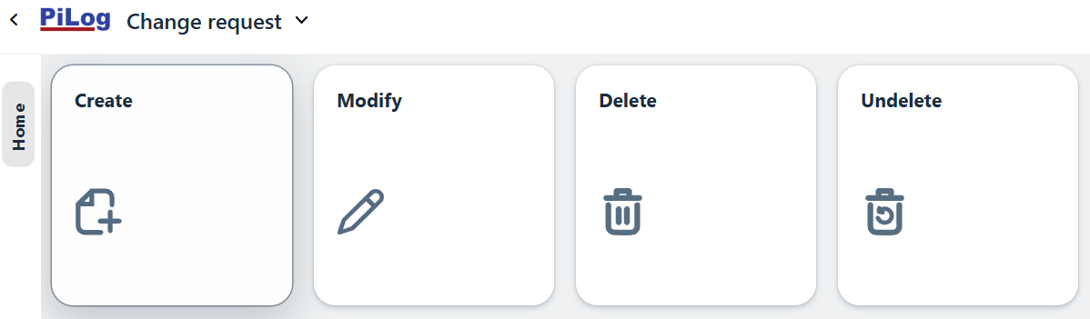
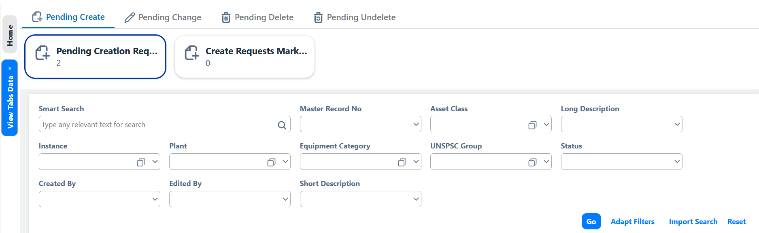
UI5 Theme
www.piloggroup.com
Restricted Use

Slide 82
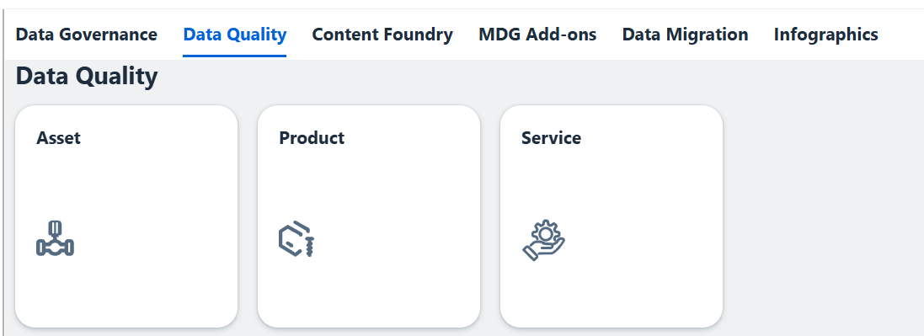
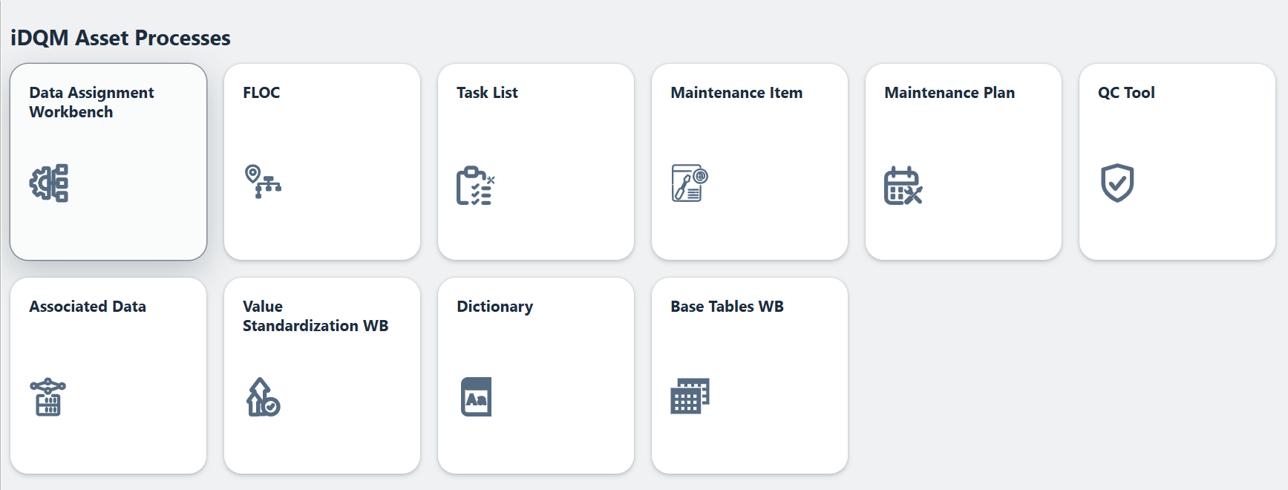
UI5 Theme
www.piloggroup.com
Restricted Use

Slide 83
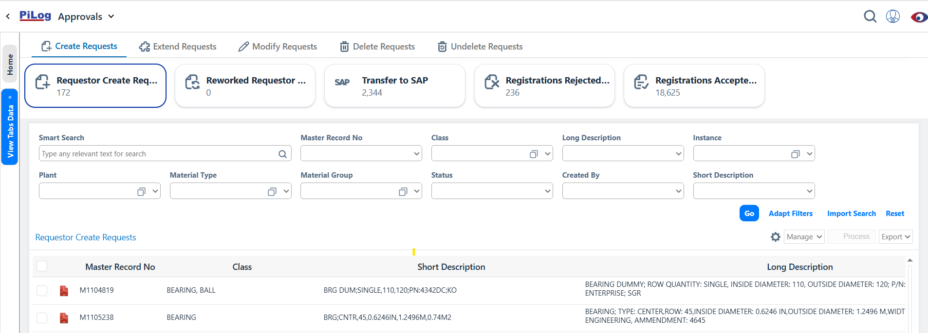
UI5 Theme
Enhanced user friendly screens as of SAP Fiori Look & Feel
www.piloggroup.com
Restricted Use

Slide 84
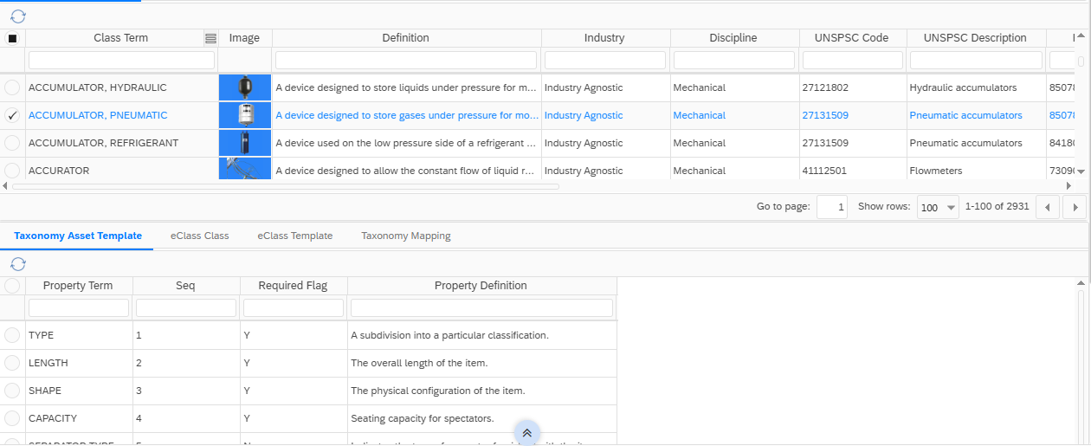
UI5 Theme
Taxonomy view along with Classification, Standard Image
www.piloggroup.com
Restricted Use

Slide 85
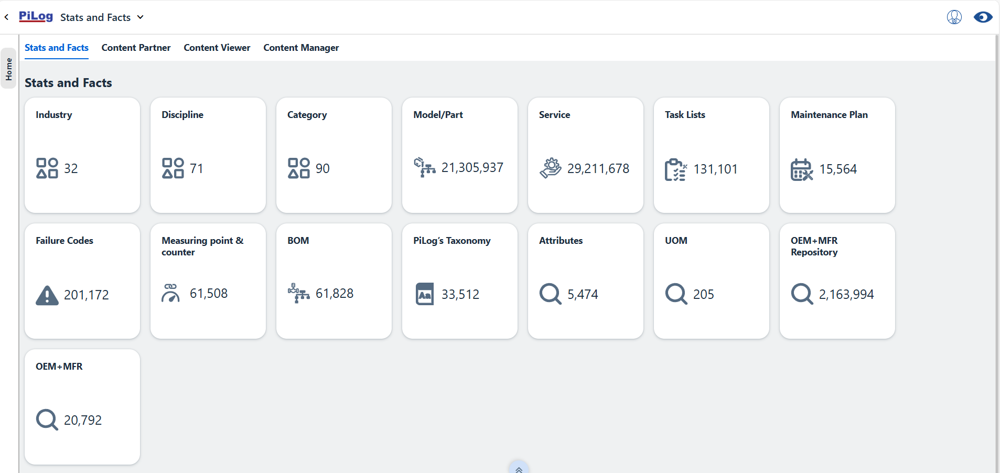
UI5 Theme
Stats and Facts in iContent Foundry
www.piloggroup.com
Restricted Use

Slide 86
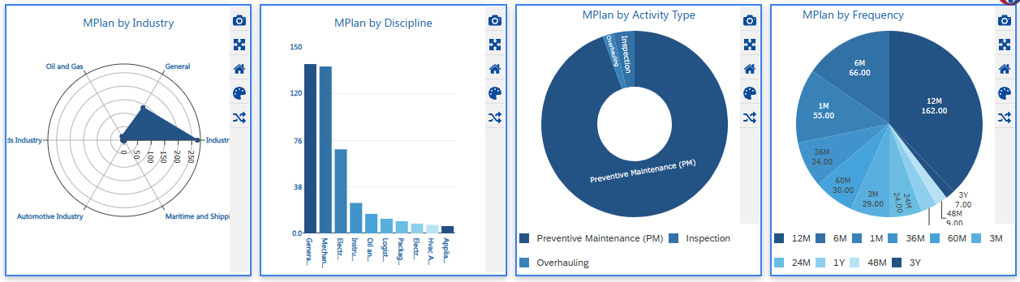
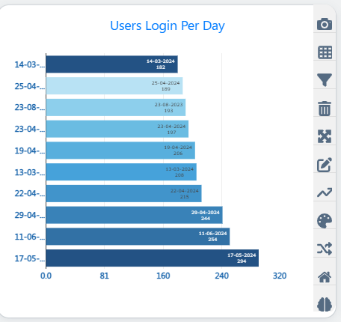
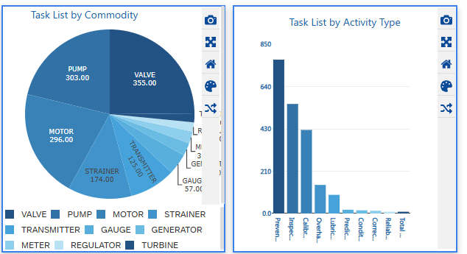
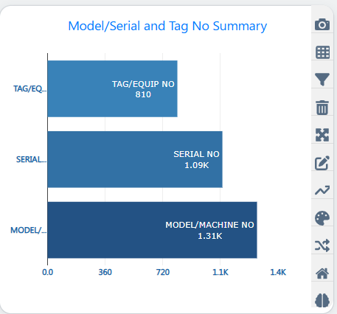
InfoGraphics
www.piloggroup.com
Restricted Use

Slide 87

Impactful Business Value Management with DQG
Time & Cost Reduction
& Potential Saving
Improved Inventory
Visibility
Support Maintenance &
Operations during shutdowns
Cost avoidance by using
non- or slow-moving items
Standardized short &
long descriptions
Zero down time during
maintenance
Supplier to Material & Product
Category Linkage:
to improve searching and
easy identification
as spares availability
would be HIGH
Easy approach to suppliers in case
the materials found but the owner of
the spare refuse to release
Extended Partnership
Domestic Vs. Import
Build the foundation and strengthen
the relationship among companies
Provide accurate information for
local content and decision making
www.piloggroup.com
Restricted Use

Slide 88
Data Governance Architecture
www.piloggroup.com
Restricted Use

Slide 89



PiLog System Landscape (On-Premise)
PiLog MDRM Database server
Base tables data
Access Control
Roles, User & Security
Operational data
Classification data
PiLog MDRM integrates with Oracle FUSION using OIC Web services
Synchronous seamless connectivity will be established between PiLog MDRM with Oracle FUSION for pushing each Request and capturing Response
JDBC & JNDI
Web Service
Oracle Fusion
PiLog MDRM Application server
Real time integration with Oracle FUSION
Direct call from PiLog MDRM Java
BL to OIC Web service
WS Client
ESB
HTTPS
OIC Web Service
Data Exchange
JBI runtime
Oracle Cloud Environment
Integration Processes
MM Records
SM Records
Hosted Facility
Customer Facility
www.piloggroup.com
Restricted Use

Slide 90
Project Structure
www.piloggroup.com
Restricted Use

Slide 91
Roles & Responsibilities
Responsibilities
Time Commitment
Overall guidance and direction
Review and resolve critical decisions & bottlenecks
2 Hours per Month
Steering Committee
Business Requirements Validation & Sign Off
Consolidate and Conflict Resolution for varied requirements
Change Management Control
Directions to the Project team
Lead Adoption in the respective areas
Ensure User availability for UAT & Training
2 Hours per Week
Business process Owners
As-Is Process Inputs
Blueprint validations
Data Review & Validation
Providing Missing Data
15-20 Hours Per Week
Project Core Team
www.piloggroup.com

Slide 92
Project Governance
Monthly
Fortnightly
Weekly
Daily/Regularly
Strategic Program Governance
Steering Committee Meeting
Operational Program Governance
Business Process Owners Meeting
Delivery Program Governance
Project Team Meeting
Activities
Domain Specific Teams
www.piloggroup.com

Slide 93
Project Key Assumptions
www.piloggroup.com
Restricted Use

Slide 94
Key assumptions (1/2)
Data extract from source systems will be extracted by EL-Sewedy and given to PiLog in excel along with any documentation needed
Design decisions business rules for data validation, cleansing and enrichment will be decided and frozen during the Business process Analysis session (Planning, Discovery & Diagnostics Phase)
Project will be executed on Onsite – Offsite model
Data Cleansing will be executed from PiLog offshore offices post NDA and regulatory signed agreements
EL-Sewedy to arrange QC engineers to review the cleansed Data and Provide inputs where required
Any new requirements which are not part of the agreed scope defined with assumptions would follow the Change Control procedures will have changes in timelines and commercials
Any other activity and deliverables not stated in the document are considered out of scope
Dictionary will not be part of data cleansing and enrichment deliverables however the class name and attributes will be part of the generated short and long description where value exists

Slide 95
Key assumptions (2/2)
Data Cleansing will be done only in English Language
The electronic data enrichment limited to the OCM items with Genuine Manufacturer Part numbers provided in the source data as well as the available information in the external sources such as web research and PiLog repository (where applicable, and not necessarily to obtain all the mandatory attribute values)
All the documents required by PiLog related to the scope of work will be delivered by EL-Sewedy to PiLog in a soft copy
PiLog proposal and Assumption will form an integral part of any future agreements between PiLog and EL-Sewedy
PiLog will submit the potential duplicate resolution reports (Type 1&2) by the end of the cleansing project. However, it will be the responsibility of EL-Sewedy to confirm the duplicates and update the same in the ERP
The Final item import template (TO-BE) will be supplied by EL-Sewedy prior the data mapping exercise along with Any ERP related data or default values related to ERP configuration and business rules
Data upload of item import template into ERP will be the responsibility of EL-Sewedy . PILOG will supply the same in the predefined item import template format
Governance Solution will be Implemented in & defined Locations
Governance solution will be integrated with Oracle EBS for all El Sewedy Business Units

Slide 96
In scope and out of scope
In Scope
The Details provided in Current Document along with the assumptions
Out of Scope
Networking, Infrastructure and other physical connections are considered out of scope in case of MDRM implementation
Servers and Oracle database in case of Governance implementation
Inventory optimization, Equipment criticality, physical enrichment
Any labor work to shift or merge stock or stack items or boxing/un-boxing
Submission of Material Master Dictionary or hierarchy, however, all the material’s specification and attribute values will be provided by PiLog as part of the short and long (PO) description otherwise it will be managed within MDRM if implemented
Condition Assessment to check whether the materials are working or not.
Any new requirements which are not part of the agreed scope defined with assumptions/Notes would follow the Change Control procedures with changes in timelines and commercials
Physical verification during cleansing process

Slide 97
PiLog Assures Best in Class Value Driven Solutions for Esteem Partners of Your Stature!!!
Thank you
Umar Farooq– Head of Sales
Umar.Farooq@piloggroup.com
Phone Number: +966-538313802
97
www.piloggroup.com

